Slide 1
Innovation in the Digital Matrix
Designing for the new era

Slide 2









BATELCO Group: Past & Present
1997
National Incumbent
Telecom Operator
2016
International Telecom Player with High Value Businesses in
14 Markets
Jordan
KSA
Internet E-mail
Mobile
Yemen
Bahrain
Kuwait
Telex Fax
Fixed-Line
Guernsey, Jersey,
Isle of Man
Falkland Islands,
Ascension Islands
Saint Helena, Diego Garcia
Maldives
Egypt

Slide 3

BATELCO Group: Footprint
Through its Acquisition of CWC’s Islands Division, BATELCO has successfully Enhanced and Diversified its Geographic Presence
MENA Assets
Non-MENA Assets







Maldives
Rank: # 1 Incumbent
Bahrain
Rank: # 2 Mobile; # 1 Broadband; # 1 Fixed
Channel Islands & Isle of Man



Guernsey
Rank: # 1 Incumbent


Jordan
Rank: # 2 Mobile; # 2 Broadband



Isle of Man
Jersey
Rank: # 2

Jersey
Guernsey



Kuwait
Rank: # 1 Broadband
Isle of Man
Rank: # 2
Jordan
Kuwait
Egypt
Bahrain
South Atlantic & Diego Garcia
Egypt
Saudi
Arabia



Falkland Islands
Rank: # 1
Yemen





Ascension Islands
Maldives
St Helena Island
Rank: # 1
Saudi Arabia
Diego Garcia
St. Helena



Ascension Island
Rank: # 1




Yemen
Rank: # 3 Mobile
Falkland Islands
Diego Garcia
Rank: # 1
Non-MENA Assets

Mobile

Fixed

BB

Pay TV
Enterprise, Data and Other
MENA Assets

Slide 4
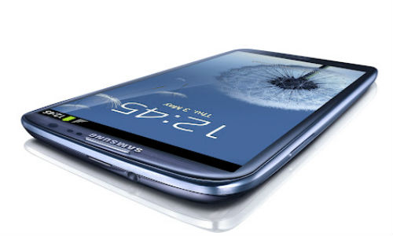
TELECOM’S QUICK STATS: AN INDUSTRY FOR THE DECADE
6.3b
Mobile Lines
4.4b
Unique Users
4.2b
Use SMS
2.1b
MMS Users
1.8b
3G Users
1.2t
Industry Revenue
1.2b
Personal Computers
1.0b
Registered Vehicles
1.1b
Landline Phones
1.7b
Credit Card Users
1.6b
Television Sets
1.6b
Have No Electricity
5.0b
Have a Job
1.0b
Facebook Users
2.3b
Internet Users
2.2b
Unbanked Persons
3.9b
Radio Receivers
4.2b
Have a Toothbrush
1.4b
Email Users
2.3t*
Internet Revenue
*BCG G20 Internet Economy Value (2010)

Slide 5





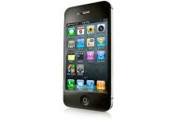
TECH CYCYLES TEND TO LAST 10 YEARS
THE NEXT COMPUTING CYCLE BEGAN WITH THE iPHONE LAUNCH IN 2007
Mainframe Computing
1960s
Mini Computing
1970s
Personal Computing 1980s
Desktop Internet Computing
1990s
Mobile Internet Computing
2000s

Slide 6
FIRST GENERATION OF RE-IMAGINATION - AFTER 125 YEARS, LANDLINES WERE SURPASSED BY MOBILES IN 2002
Global Fixed Telephone Lines vs. Mobile Subscriptions, 1994-2012
2012
6.3b Mobile Subscribers
6,000
Fixed Telephone Lines
Mobile Subscriptions
5,000
4,000
3,000
2002 : Inflection Point
Mobile > Landlines
2006
LandLines Peaked at 1.3b
2,000
1,000
1994
1996
1998
2000
2002
2004
2006
2008
2010
2012

Slide 7
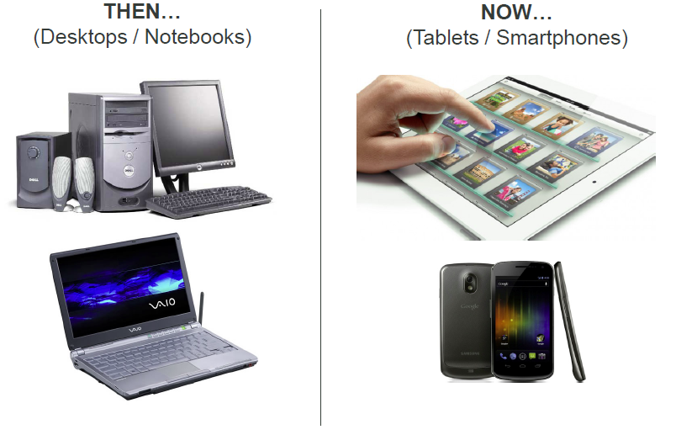
RE-IMAGINATION OF COMPUTING DEVICES

Slide 8
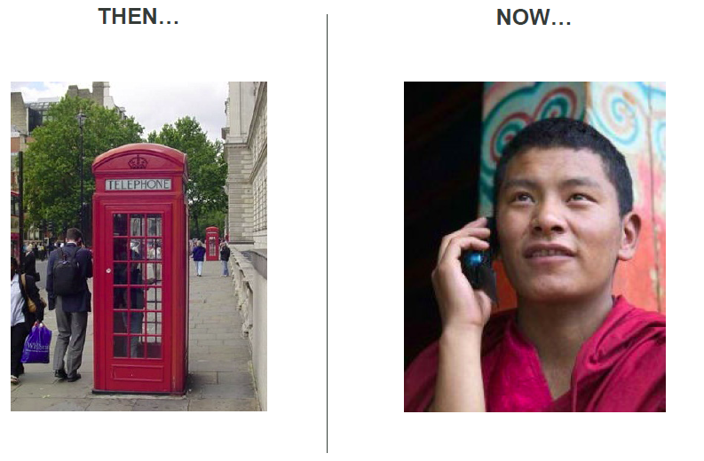
RE-IMAGINATION OF CONNECTIVITY

Slide 9
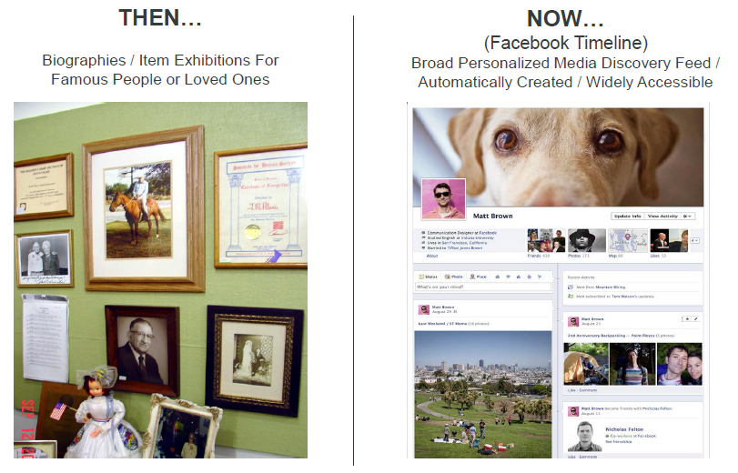
RE-IMAGINATION OF LIFE STORIES

Slide 10
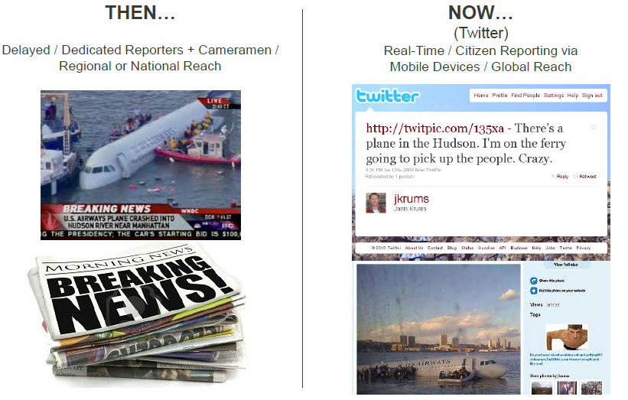
RE-IMAGINATION OF NEWS & INFORMATION FLOW

Slide 11
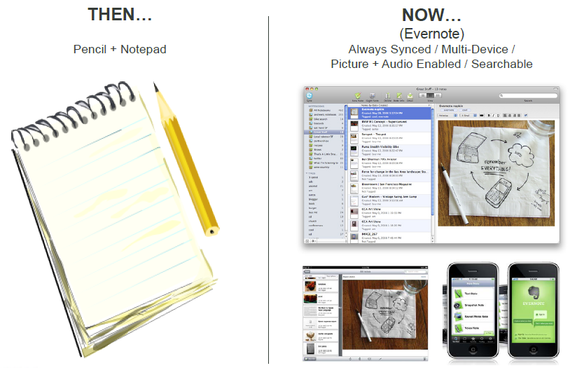
RE-IMAGINATION OF NOTE TAKING

Slide 12
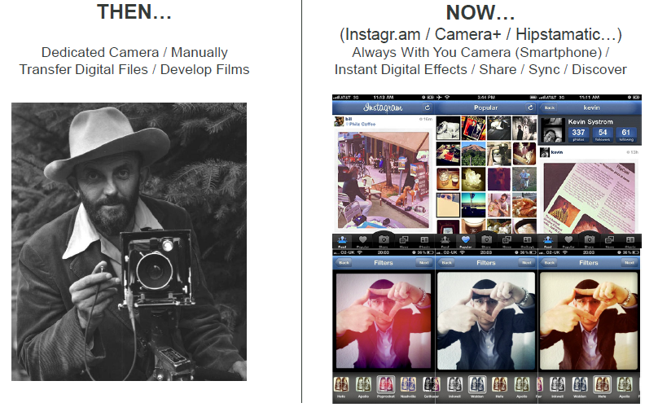
RE-IMAGINATION OF PHOTOGRAPHY

Slide 13
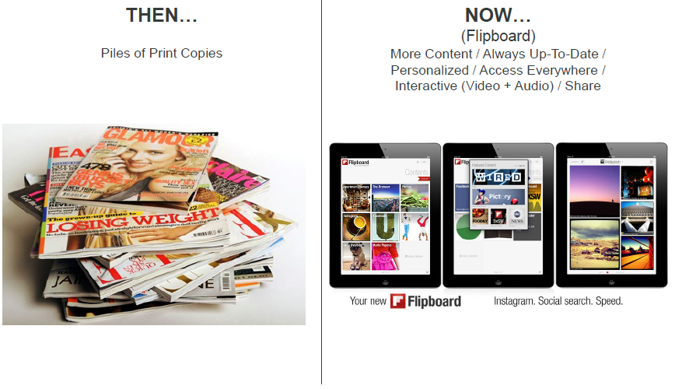
RE-IMAGINATION OF MAGAZINES

Slide 14
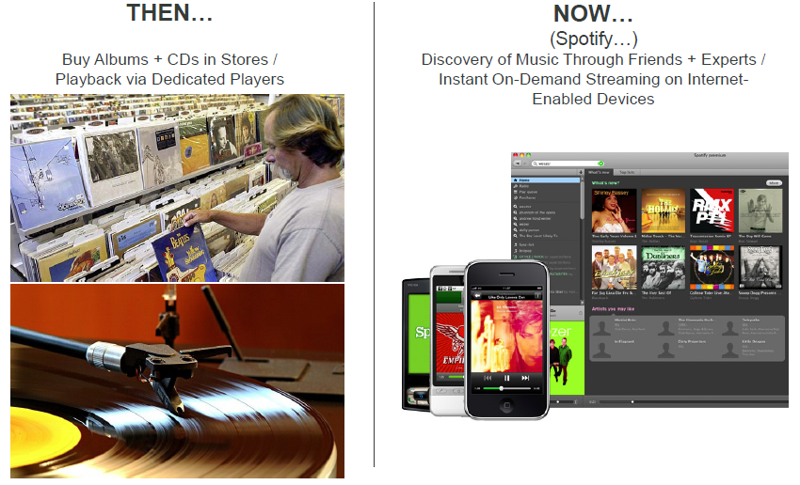
RE-IMAGINATION OF MUSIC

Slide 15
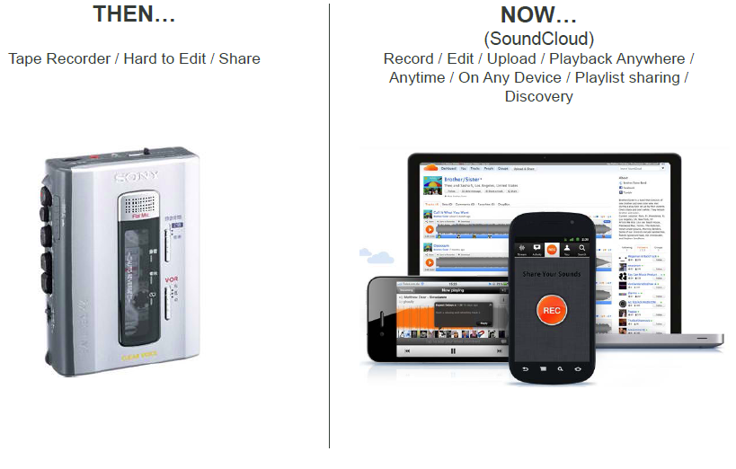
RE-IMAGINATION OF SOUND

Slide 16
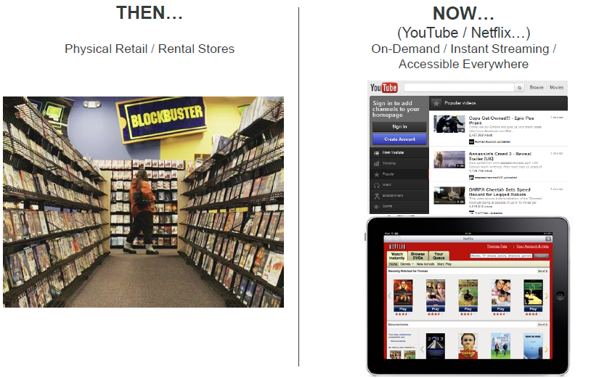
RE-IMAGINATION OF VIDEO

Slide 17
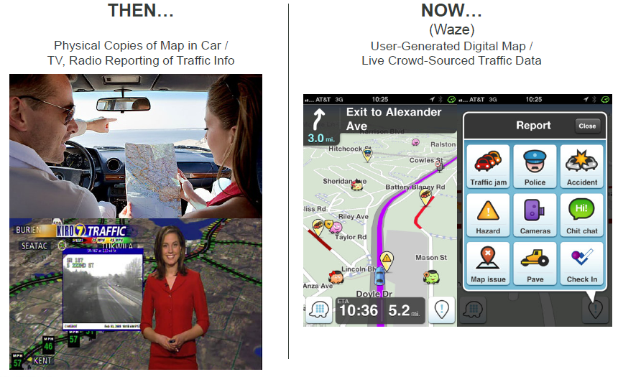
RE-IMAGINATION OF NAVIGATION & TRAFFIC INFO

Slide 18
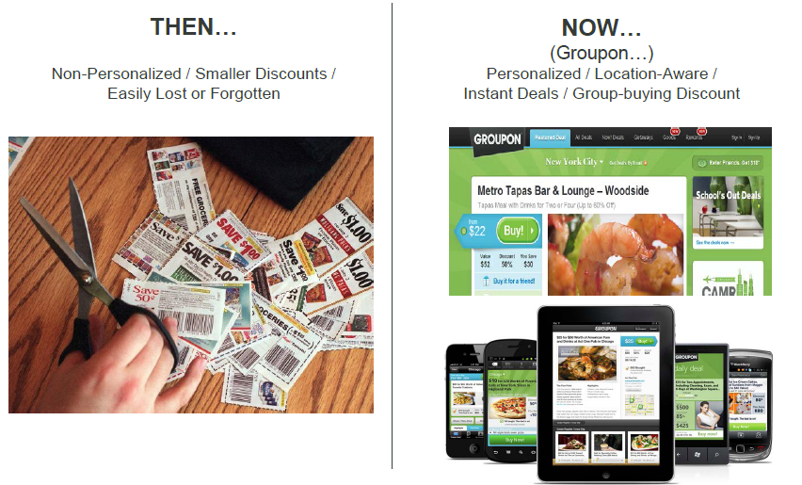
RE-IMAGINATION OF COUPONS & LOCAL SERVICES

Slide 19


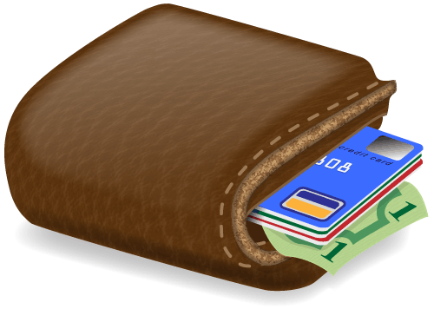





RE-IMAGINATION OF TELECOMS
Loyalty
Loyalty schemes
Personalized offers
Incremental services
Multiple cards
Ticketing
Transport ticketing
Airline check-in
Parking
Venue access
Payments
Point-of-sale payment
Vending machines
Utilities
Multiple cards
Information Sharing
Peer-to-peer
vCard distribution
Social networking and location based services
Call request
SMS notification
Education
Marketing & Advertising
Smart poster
Targeted consumer information
Leisure
Data Collection
Vouchers and Coupons
Vouchers
Social media
Consumer reach
Targeted marketing
Identity
Health
Public health
Prescription tracking
Events
Workforce management
Asset tracking
Vehicle information
Access Control
Smart poster
Targeted consumer information
Leisure
Data Collection

Slide 20

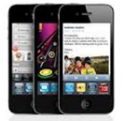








A FUNDAMENTAL SHIFT IN CONSUMER BEHAVIOR IS TAKING PLACE FROM BRICK-AND-MORTAR TO DIGITAL SERVICES
Consumers radically shifting their behavior to the online world
...and mobile also becoming integral part of daily life
79%
of people shopping on smart phones
Shopping:
400 Mn users
68%
use applications
48%
watch videos
Social: 901 Mn
FB users
Gaming:
250 Mn users
What are people willing to give up for Internet usage on Smart phones?
VOIP: 250 Mn Skype users
Apps: 15 Bn+
Apple apps downloaded
Music: 10 Bn+
iTunes songs
downloaded
43%
Beer
36%
Chocolate
34%
Superbowl
tickets
26%
High
heels
20%
Cable TV
Note: Data on left-hand side as of Q1 2012
Source: SNL, Euromonitor; Facebook, Pyramid, Endgaget, Appdata, GlobelWebIndex, KPCB Top Mobile Internet Trends 2011, IDC Mobile VoIP report, Google report: the mobile movement, BCG analysis

Slide 21
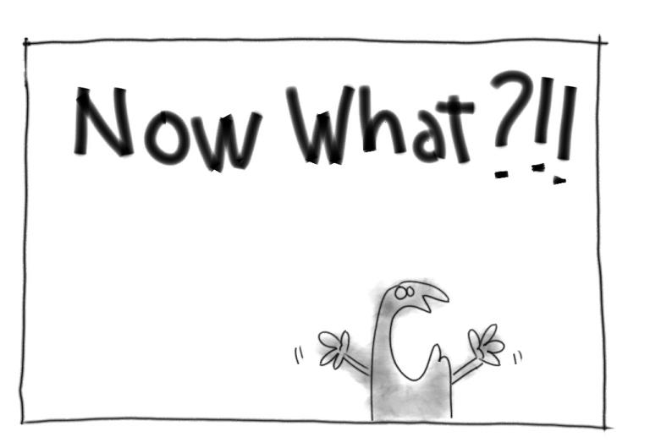
WHAT CHANGED ?!!

Slide 22
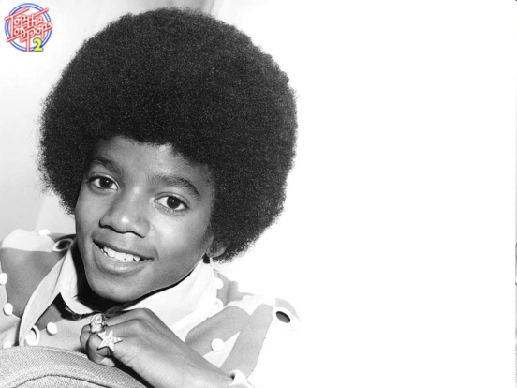
THE CHANGING NATURE OF THE CUSTOMER…

Slide 23
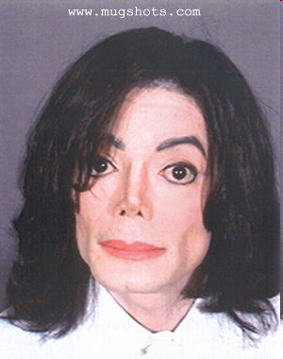
THE CHANGING NATURE OF THE CUSTOMER…

Slide 24
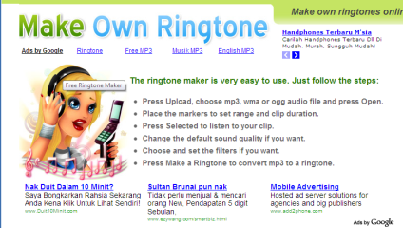
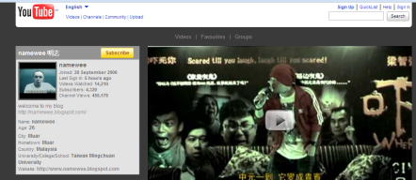
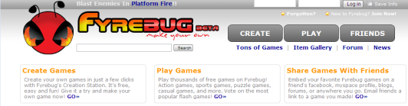
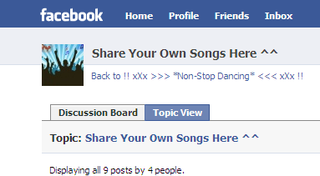

THEY ARE MAKING THINGS THEY USED TO BUY…

Slide 25
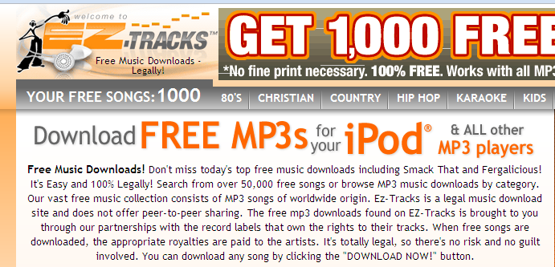
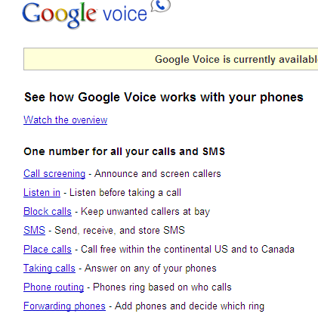



THEY ARE GETTING USED TO A BUSINESS MODEL CALLED “FREE”…

Slide 26
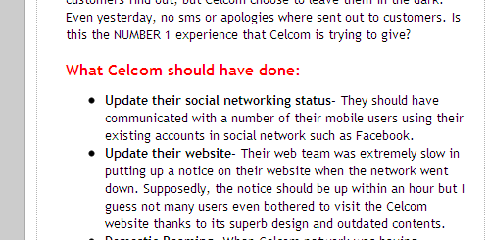

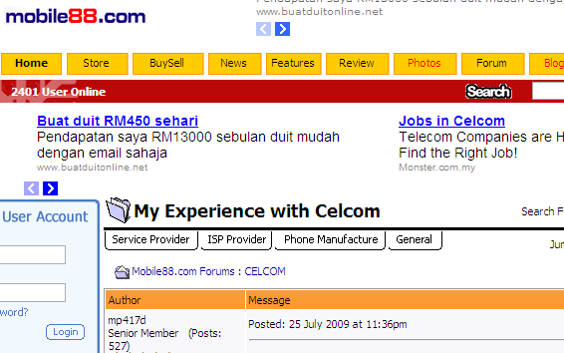
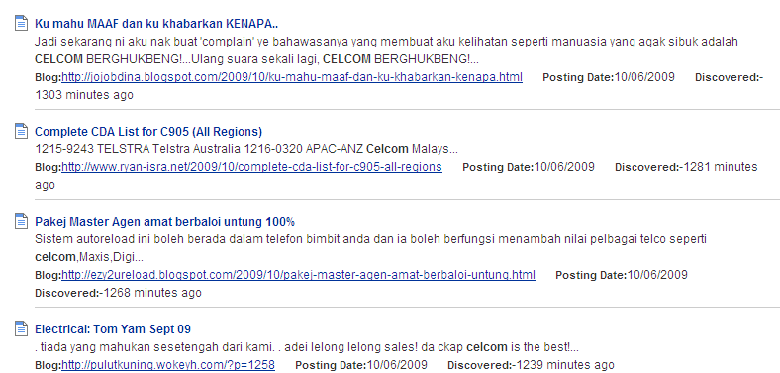
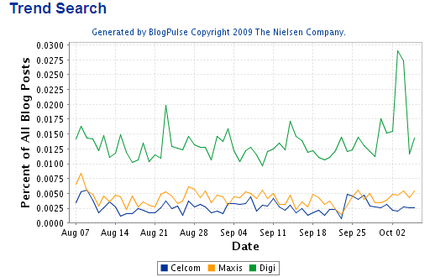
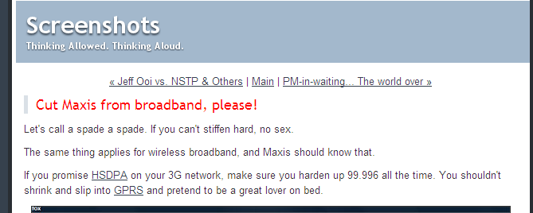
THEY WILL TELL EVERYONE WHAT THEY THINK…

Slide 27

THE RISE OF THE ACTIVIST PROSUMER

Slide 28
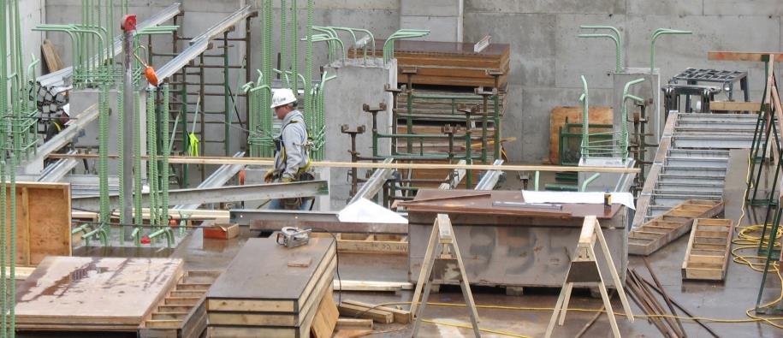
Innovating within New Development Frameworks

Slide 29
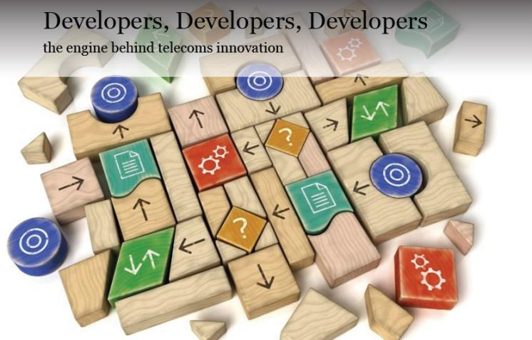

Slide 30
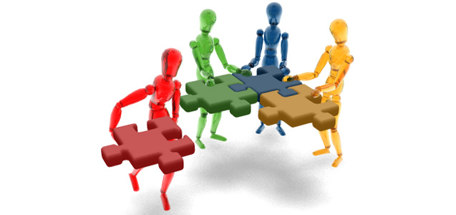
Building a product is a science
..building a community is a form of art

Slide 31

EXAMPLES

Slide 32
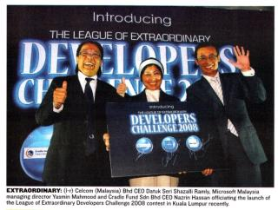
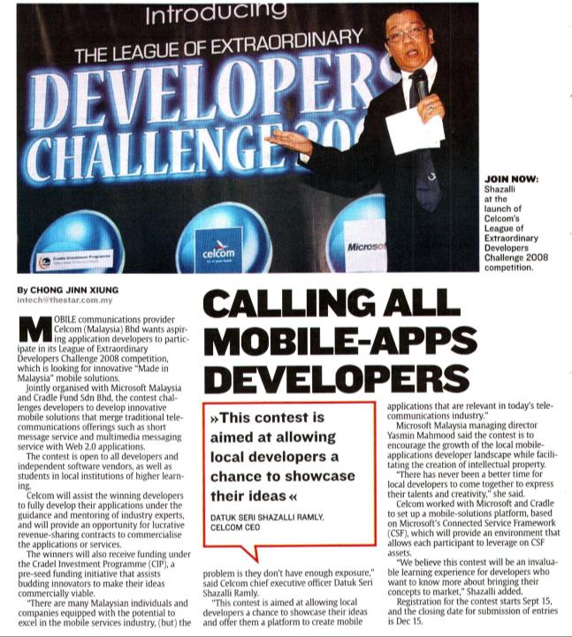
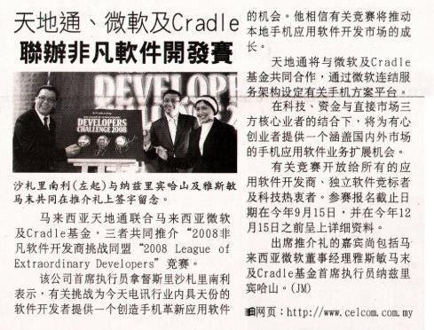
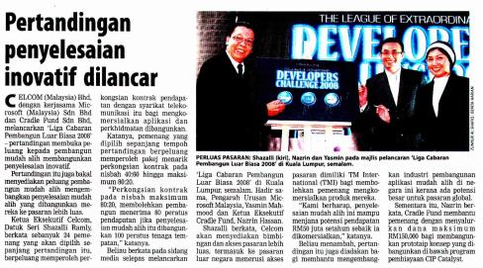
Notes:
LEDC Challenge in 2008

Slide 33
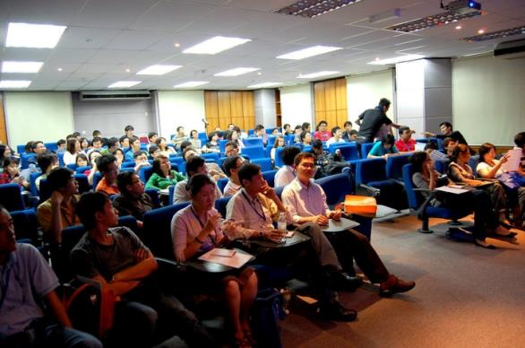
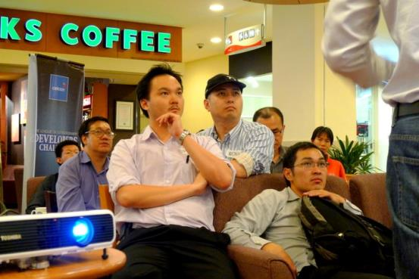
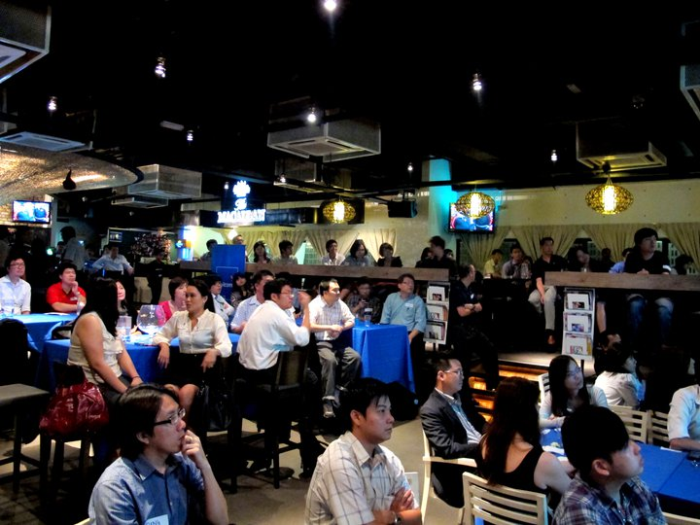
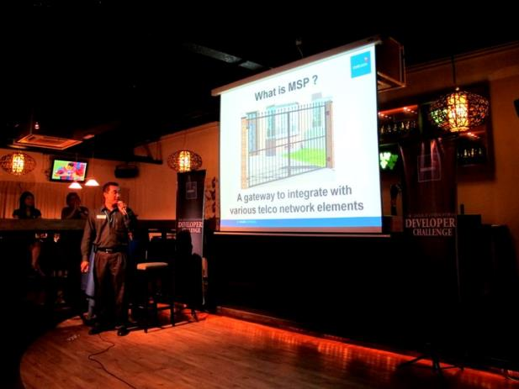
ENRICH Developers with Marketing Insights, Guest Speakers, Community Budding

Slide 34
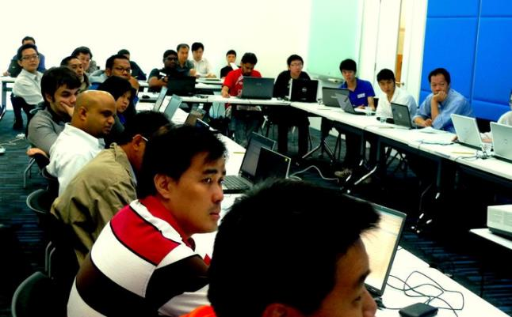
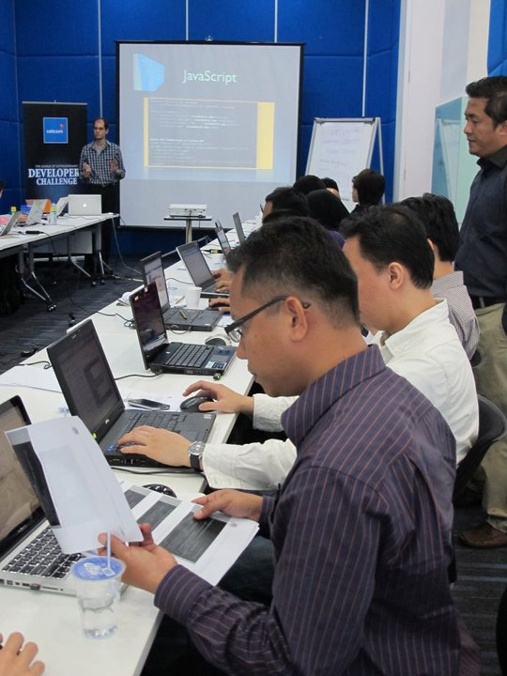
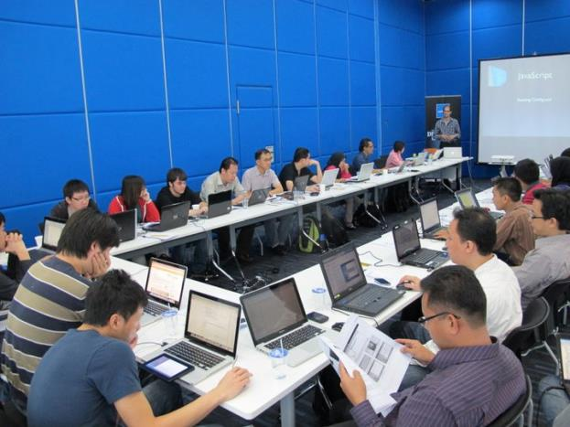
ENGAGEMENT with the Developers through Hands-on Training
Notes:
Every LEDC’s Program begins with a Hands-On Training

Slide 35
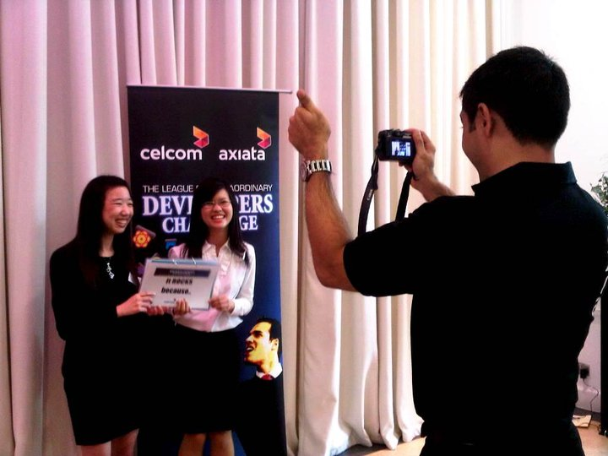
IDEAS submission through written or Video

Slide 36
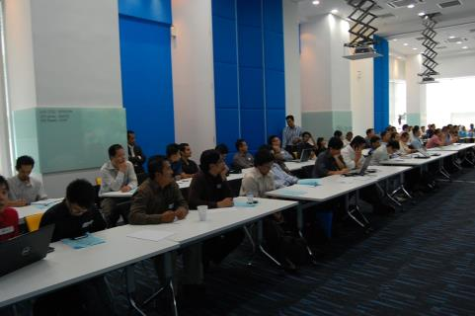
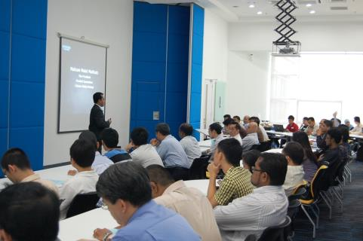
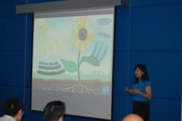
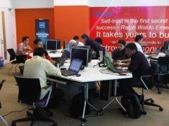
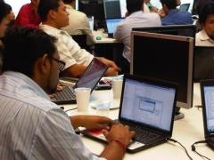




We have trained Over 500 developers in 2 years

Slide 37










Sri Lanka – IdeaMart
Ideamart Platform exposes Dialog API’s to external parties to develop mobile applications and take home 70% of the revenue earned.
Ideamart
Dialog
Universities
Developers
SME
Media
Government
Enterprise
Content
Providers
SIG
Other API providers
1000 + Community
1800 + Applications
500 + New Businesses
24 + community events
1 + Million Customers
“Create a mutually
Beneficial environments for
value, innovation and
Growth”
-Law #2, 6 Immutable laws of Mobiles, MARCO KOEDER

Slide 38





Ideamart Community Engagement
1000+ Developer Community
Idea champs – University Student Community
200 +Community driven support
24 Events for 2013 – Reaching 2,500+
Support services via Hotline, Mail, SMS App, Web Site, Social Media, Live Web Forums etc.
Idea Room to engage with Ideamart Team
An audience of over 200 at events every month
Community based Promotions

Slide 39

In times of change, learners inherit the Earth, while the learned find themselves beautifully equipped to deal with a world that no longer exists.
Eric Hoffer

Slide 40



Get in touch !!
karan.ponnudurai@batelcogroup.com
Karan Henrik Ponnudurai

