Slide 1
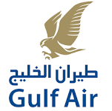
Protecting Passengers And Aviation Industry From Cyber Attacks
Presented by:
Dr. Jassim Haji
Director Information Technology
Gulf Air

Slide 2
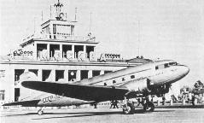
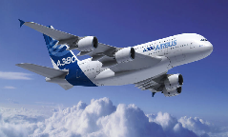
Technology Evolution for Airline
Over 100 years of aviation with the evolution in technology:
Past
Isolated and Silo Reservation and Check-in Systems
Mainframe Programs
Unexposed Distribution Sales Channels
Present
Internet of Things (IoT)
On-board Connectivity
Passenger Self Service
Cloud Technology
Big Data
Business Intelligence
Mobility
Smart Airport
Wider Distribution Sales Channels
All these technological advancements bring Security risks
Risks

Slide 3
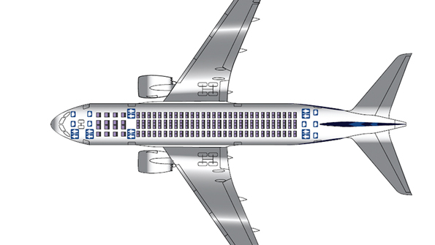
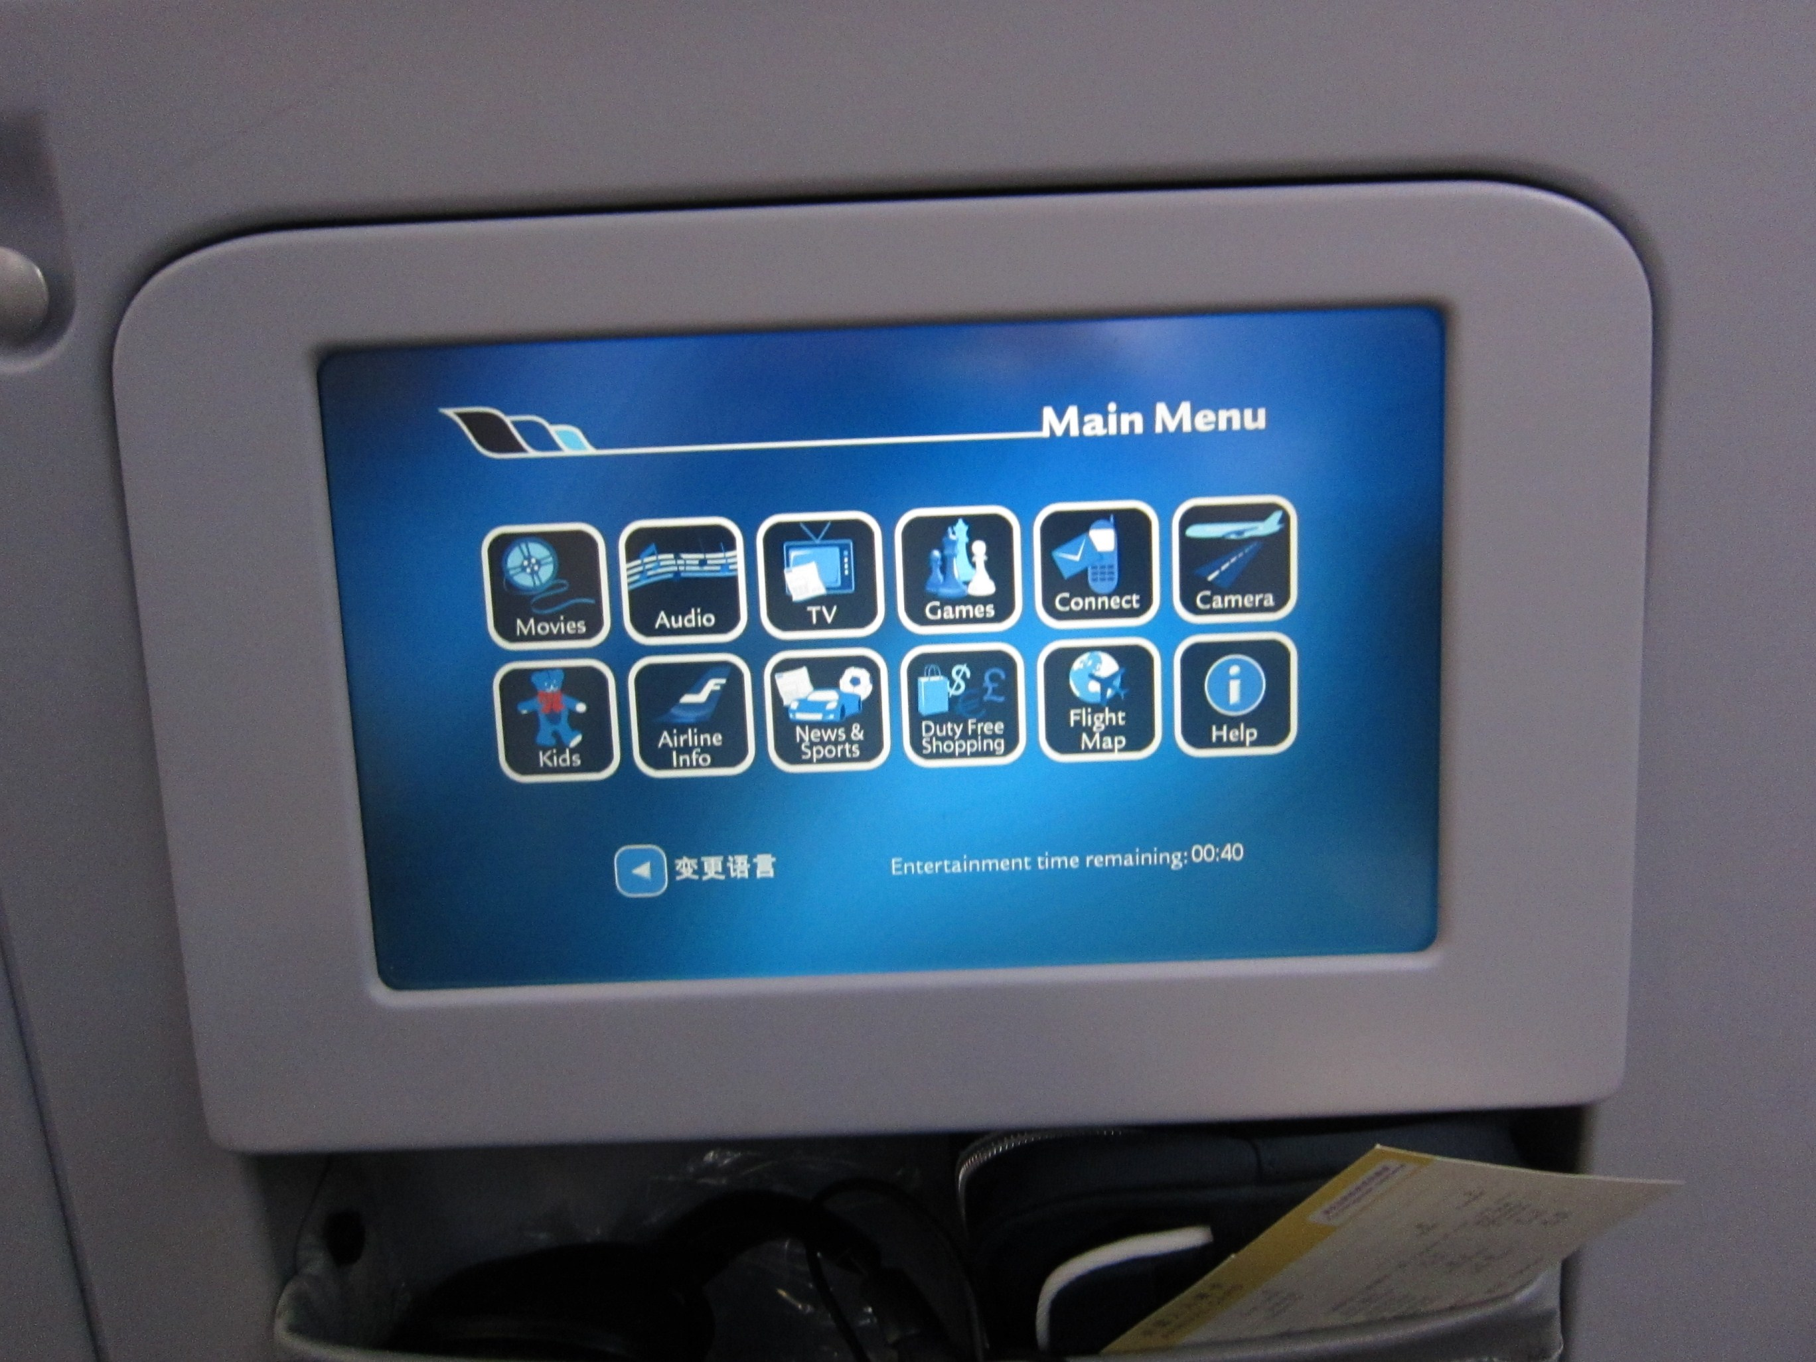
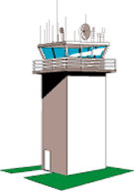
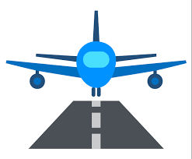
Aircraft Communication
Radars
Cabin
Announcements
IFE Systems
Radio,
GSM, Satellite,
Internet
Air control Tower
On-board Wi-Fi
Airports
Airline Office
Cockpit
Firewall
Passenger Cabin

Slide 4
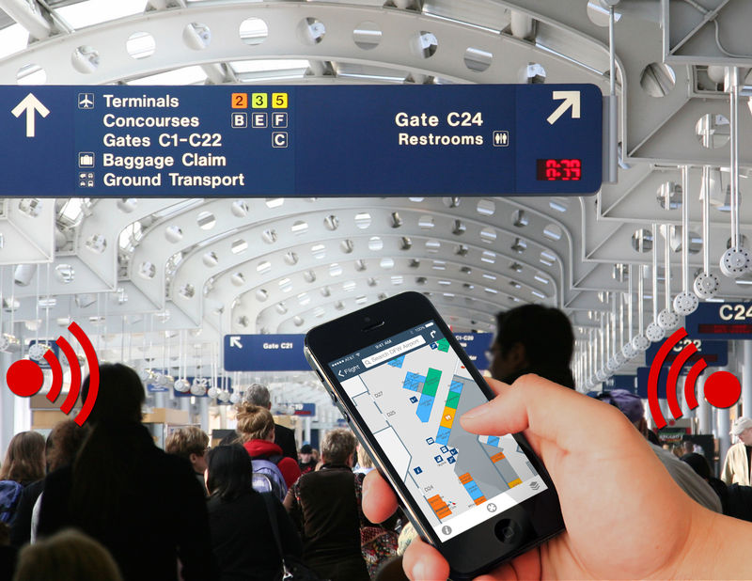
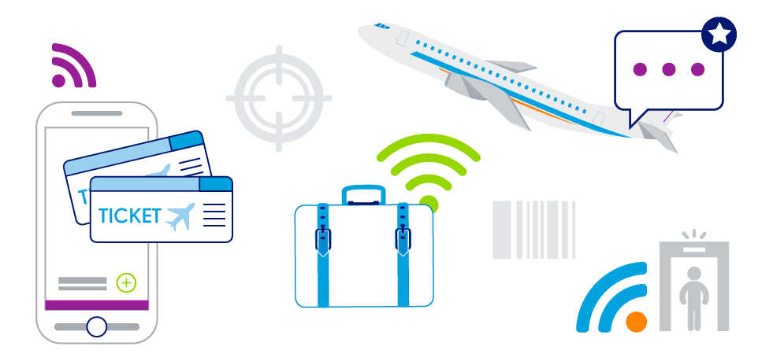
Smart Airports
IoT has also enabled the concepts of smart airports
Airport services have grown beyond the walls of the terminal building
Beacons and geo-location services
87% of passengers carry smart devices
Passenger Check-in via Internet, Mobile and kiosks
Self service Tagging, Bag drops, Boarding pass
Electronically tagged bags for easy tracking

Slide 5
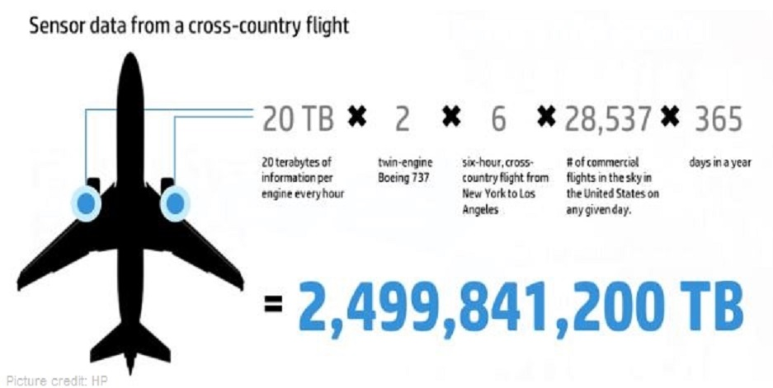
IoT in Aviation
With availability of internet in the sky and ground, along with the wide spread of sensors, IoT is taking over
Following are some of the uses of IoT with aircrafts:
Monitoring the aircraft location
Monitoring the fuel consumption
Checking aircraft safety parameters remotely
Checking health of the aircraft components
Updating flight routes
Communications between ground stations and aircraft

Slide 6
Risk of IoT in Aviation
Because of the increase number of devices and sensors, which all depend on wireless communication, the potential for intrusion is high
Breaching the security of On-board systems
Data might be subjected to unauthorized access
Manipulating the sensors data and calibrations
Deleting the data to create availability issues
Changing the data sources of the IoT sensors to get incorrect data
Denial of services due to uncontrolled and heavy traffic

Slide 7
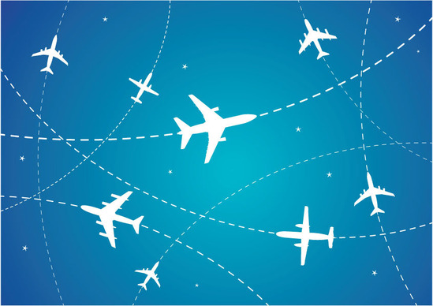
How Important is Aircraft Tracking ?
After the incident of Malaysian Airline MH370, International Civil Aviation Organization (ICAO) has passed a mandate that airlines must track their aircrafts at least every 15 minutes
To adhere to the mandate, suite of communication mechanisms with the aircraft are put in place (satellite, transponders, radio frequency) to obtain positioning data
The positioning data is readily available for commercial airlines.

Slide 8
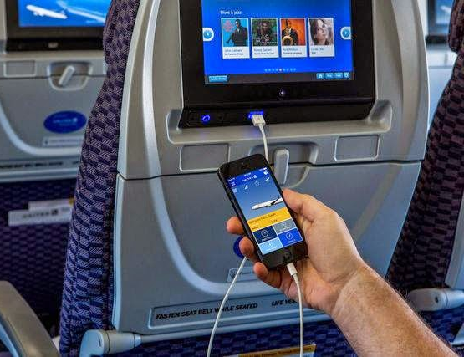
Can Aircrafts be Hacked?
Hack in the Box Security Conference 2013 – Amsterdam, Hugo Teso, a security consultant demonstrated a practical demonstration on how to remotely attack and take full control of an aircraft, exposing some of the results of his three years research on the aviation security field
Black Hat 2014 - USA, Ruben Santamarta, a cyber security expert claimed to have found a way to hack passenger jets through their in-flight entertainment systems

Slide 9
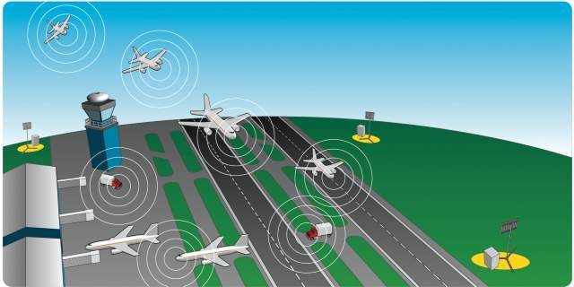
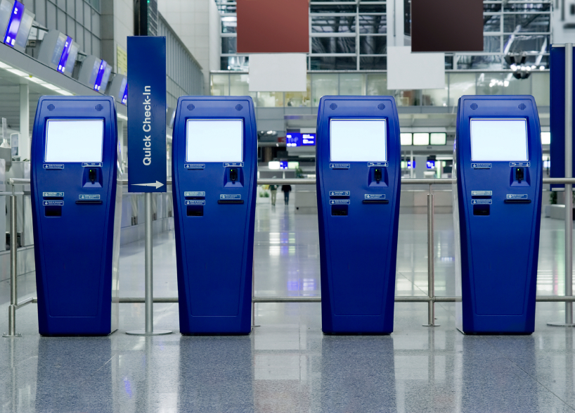
Can Air-to-Ground Comm. be Hacked?
Kaspersky Lab’s Andrey Nikishin, explained that a malicious user can influence a pilot’s decision to change the route by sending a fake message to the plane, the same be applied to spoof GPS, making the system believe that it is located in a different place from where it actually is positioned
DEFCON 22 – 2014, researchers discussed multiple vulnerabilities they discovered in airport kiosks, such as those used to check-in, purchase wi-fi time and others. These can be used by malicious user to monitor the passengers and as these devices are also networked to other systems, which can spread further attacks

Slide 10
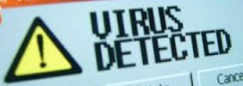
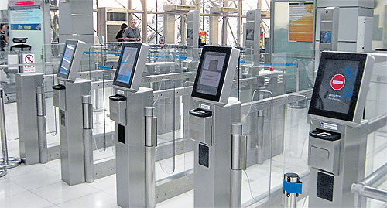
Other Risks to The Aviation Business ?
Crash of a European aircraft just after take-off in Madrid-Barajas Airport on 20th of August 2008, killing 154 people, system for monitoring technical problems on board the aircraft was reported to be infected with malware
An alleged cyber-attack led to shutdown of passport control systems at the departure terminals at 2 airports in Turkey in July 2013, causing many flights to be delayed

Slide 11
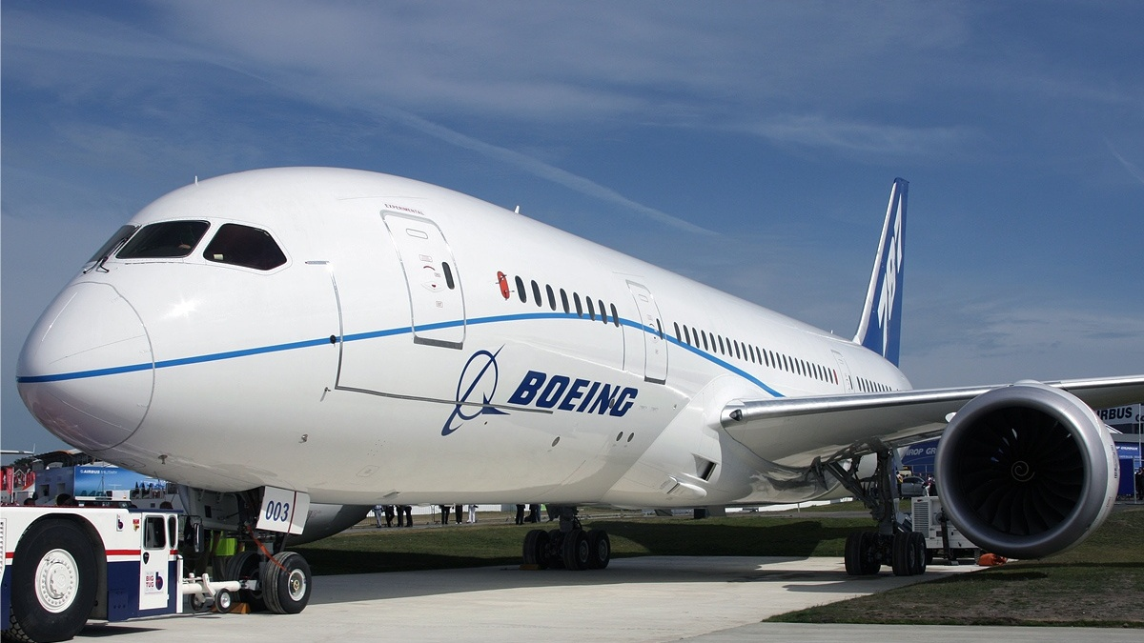
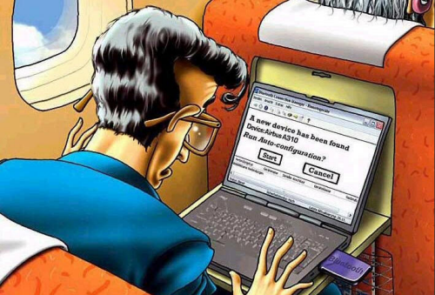
How about The Aviation Leaders ?
“Cyber-attacks are a fact of modern life. But aviation presents a special target for those who seek to damage or disrupt the integrated air transport network upon which the global economy depends.”, CEO, IATA
“The threat of cyber terrorism poses a major risk to aircrafts' systems every time they enter an airport because of the number of electronic systems they begin sharing information with and the situation will cause a lot of issues in the coming years”, VP Boeing’s defense arm
Boeing was the focus of a Cyber security scare in 2008 when an analyst claimed the firm’s flagship 787 Dreamliner passenger jet had a serious weakness in its on-board computer networks which could allow passengers to take control of the aircraft. Boeing claimed the problem had been fixed before the official report was issued.

Slide 12
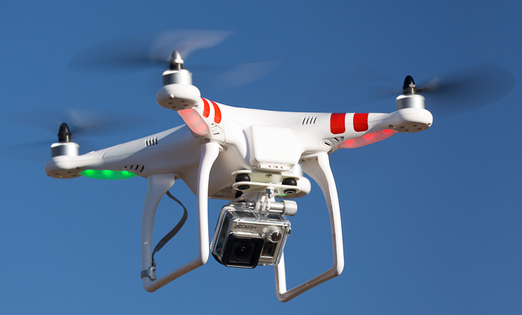
Unmanned Aerial Vehicles ‘Drones’
An unmanned aerial vehicle (UAV), commonly known as a drone, is an aircraft without a human pilot aboard
Drone are like flying robots and are controlled from a remote location through wireless communication
Different type of drones are currently being used for different operations include military applications, commercial, scientific, recreational, agricultural, healthcare sectors
The biggest advantage of the drone is its speed and low cost operations
Similar to any other technology the drones are also having certain risks

Slide 13
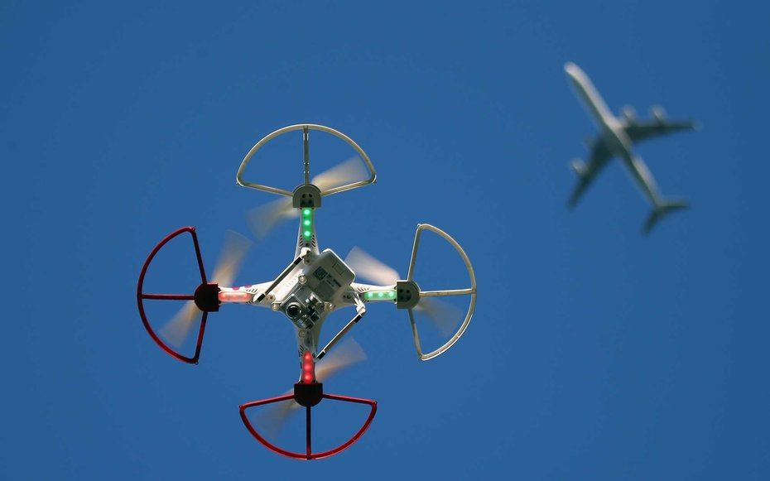
Risks of Hacking Drones
Like any other computer, Drones can also be hacked
Drone can lead to unintentional collisions or other interference with other aircraft, deliberate attacks or by distracting pilots or flight controllers.
Each month, pilots and air traffic controllers report more than 100 drone “sightings” to the Federal Aviation Administration in USA
Pilots consider drones a safety risk that must not be underestimated.
“We’re not kidding when we say it has to be mitigated as a threat,” said Tim Canoll, President of the Air Line Pilots Association, or ALPA, and a drone hobbyist himself.

Slide 14
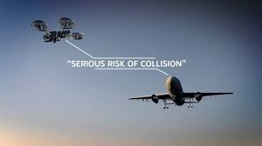
Drone Incidents
In April 2016, The British Airways flight from Geneva was hit by a drone as it approached the London airport, with 132 passengers and five crew on board
In December 2014, a drone flying near Heathrow almost crashed into a passenger jet at 700ft altitude
Civil aviation bodies around the world are drafting legislation to control the use of drones and manage the risk

Slide 15
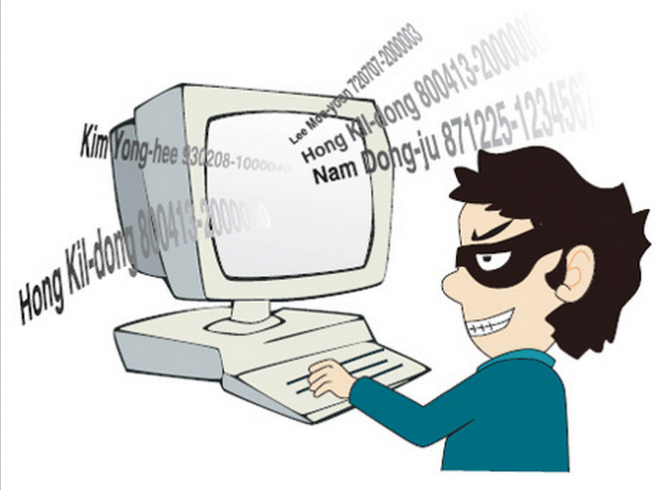
Is Passenger Information also Important ?
In July 2015, Kenyan air officials mistakenly leaked President Obama's exact itinerary – twice
In 2015, approximately 110,000 pieces of customer data may have been compromised for a large Asian airline, hack was apparently due to a malware attack on loyalty program specific users. Airline was attacked twice in one year

Slide 16
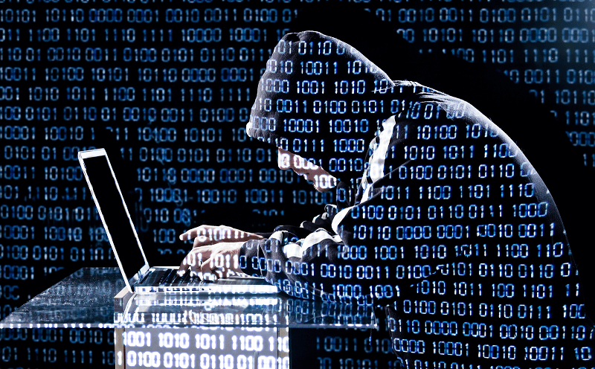
Is Passenger Information also Important ?
In 2015, America’s most important airline’s information systems were breached. It was identified that the data on the movements of millions of Americans were accessed by the hackers
In contrast to the theft of health records or financial data, the breach of airlines raises concerns related to the personal information, travelling pattern, schedule disruptions or transportation gridlock.

Slide 17
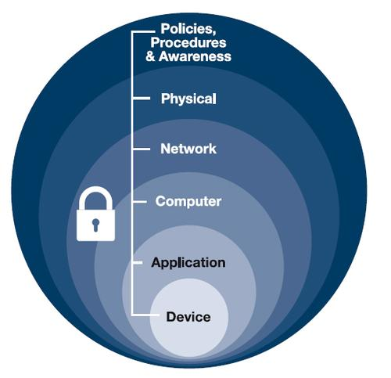
Risk Mitigations
Implement a layered approach model for security
Segment the networks based on the threat levels, with each having separate set of controls
Devices connected to the aircraft (onboard and on ground) to be hardened against the known vulnerabilities
Specialized controls to be implemented between aircraft components, ground and communication and also passenger information
Provide information security awareness to all teams
Add data loss prevention controls
Work closely with business partners to ensure secure information landscape

