Slide 1


The Use of
Social Media Tools
to Support Economic Growth
By @AliSabkar
25.10.2016

Slide 2


socialmediaclub.org

Slide 3

socialmediaclub.org

Slide 4


socialmediaclub.org

Slide 5
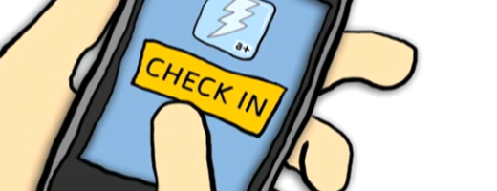
Documentation / Tell a Story…
Check-in:
Facebook / Twitter / Foursquare / Instagram
#ArabICT
socialmediaclub.org

Slide 6
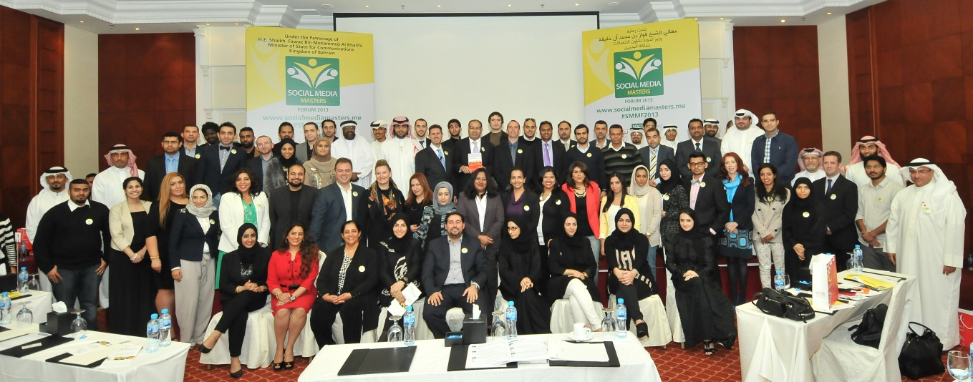
Social Media Club
Founded in 2006 in California. USA. Managed by a global board of directors.
Social Media Club is the largest non-profit trade organization for social media professionals. More than 350 chapters from 6 different continents.
Connecting media makers from around the world to promote media literacy, industry standards, ethical behavior and to share the lessons they have learned.
socialmediaclub.org

Slide 7

What is Social Media?
Social Media refers to the use of web-based and mobile technologies to turn communication into an interactive dialogue.
socialmediaclub.org

Slide 8

What is Social Media?
Technology that facilitates communication and sharing by using a platform.
Platforms are changing
and evolving all the time.
If your customers are on
social media, you should be
contacting them there!
socialmediaclub.org

Slide 9
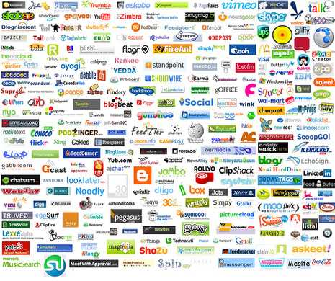
Social Media Networks
+1600 Social Media Networks Global
socialmediaclub.org

Slide 10
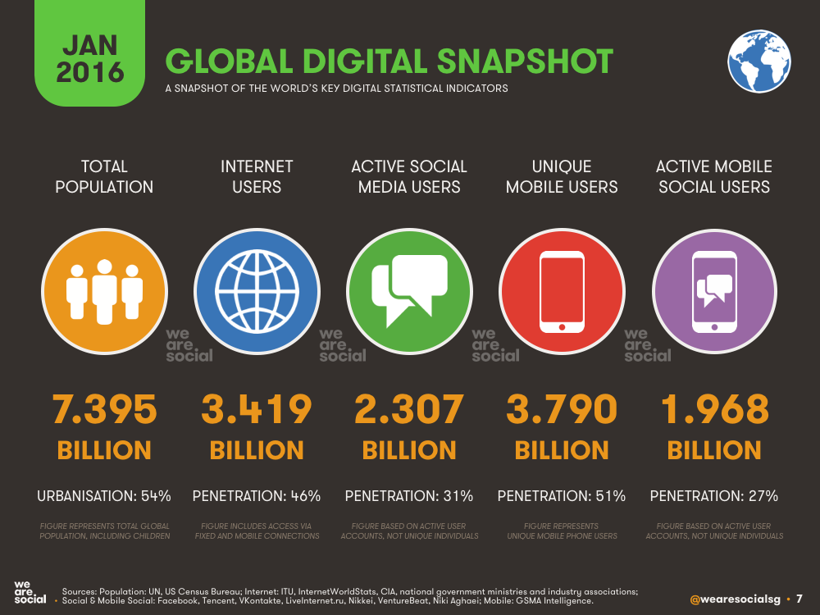

Slide 11
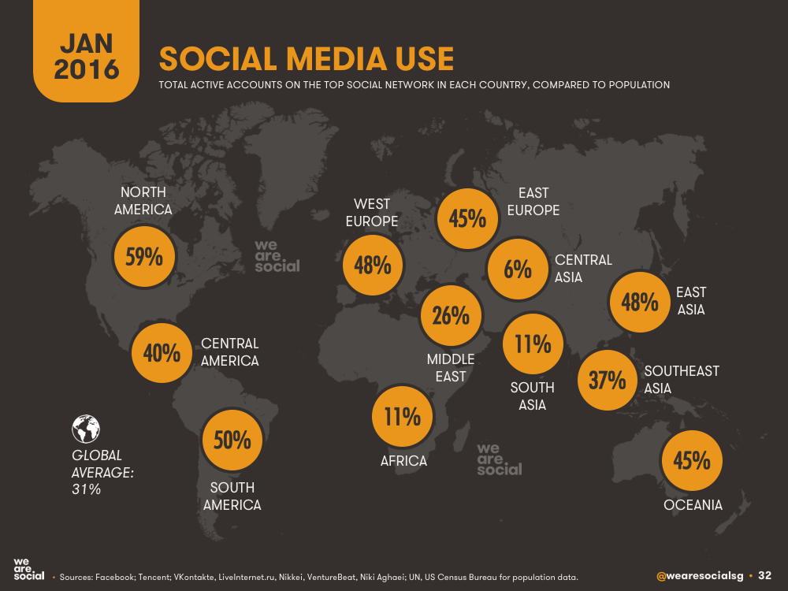
Social Media Learning
socialmediaclub.org

Slide 12
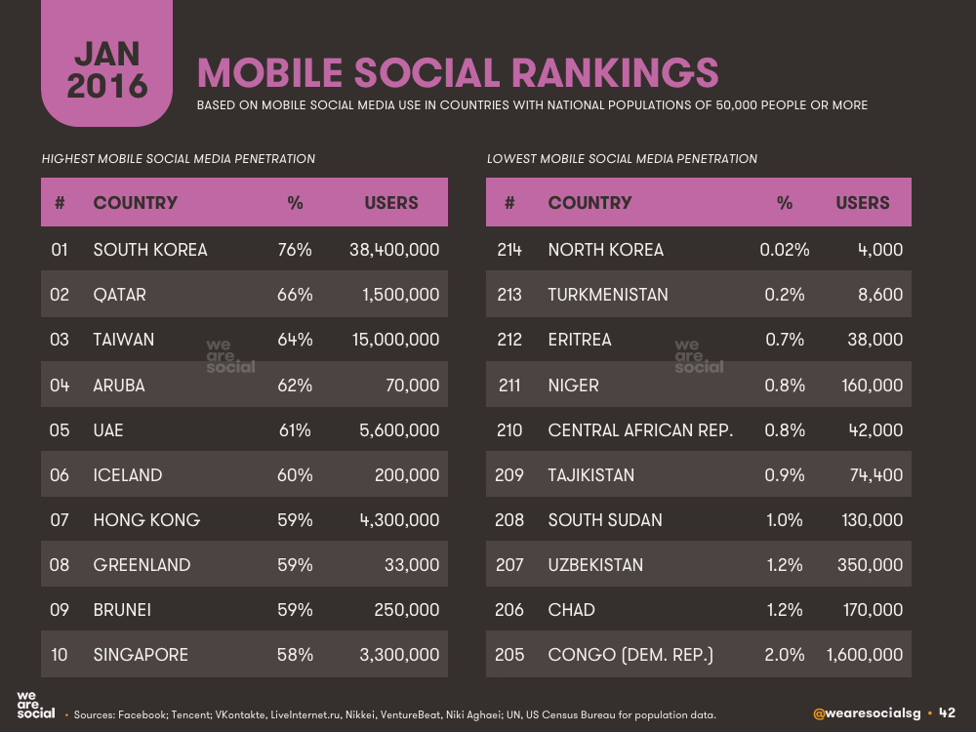
Social Media Learning
socialmediaclub.org

Slide 13



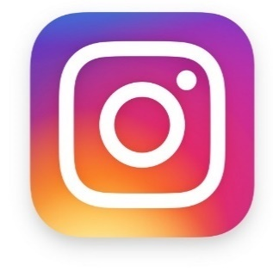



Biggest Social Media Networks 2016
+1.7 Billion users
Global Population:
@facebook
China
India
@whatsapp
@wechatapp
@tumblr
@instagram
U.S.
@twitter
Indonesia
@snapchat
Brazil
@linkedin
+700K users
+400 Million users
+250K users
+313 million users
+230K users
+380 million users
+320K users
socialmediaclub.org

Slide 14












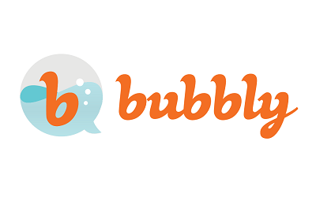


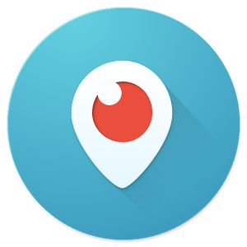

TOP Social Media Networks
socialmediaclub.org

Slide 15

Power of Social Media
    Affordable
    Manageable
    Effective
    Mobile
You can not only gain the attention of your audience but you can keep them coming back for more!
socialmediaclub.org

Slide 16
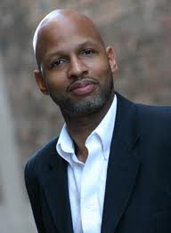
Social Media for Organizations
Social Media
Does Not Work For Organizations…
“David Bullock, Co-Author - Barack2.0”
Without The Practical Knowledge, Technology, Tools
And Know-How.
socialmediaclub.org

Slide 17
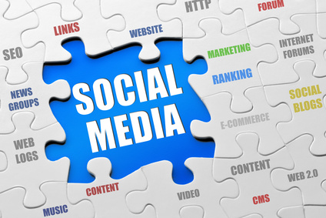
Social Media Puzzle
socialmediaclub.org

Slide 18
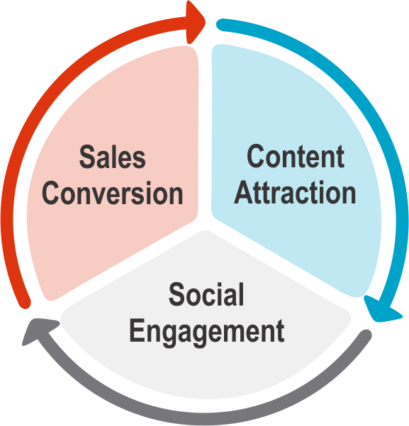
The Social Marketing Process
www.jeffkorhan.com
socialmediaclub.org

Slide 19
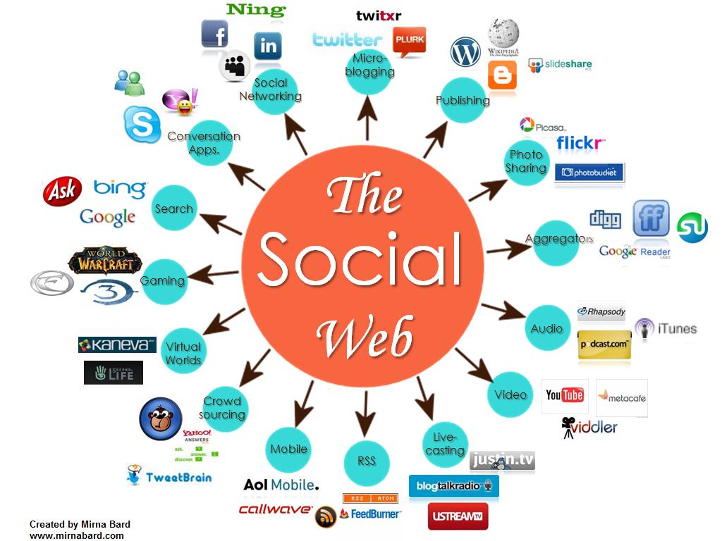
Content Sharing
Conversational Calendar
Ask your community - take polls and share results
socialmediaclub.org

Slide 20

Measure your Social Media KPIs
Awareness, Engagement, Size
Rate of Engagement
Number of Fans / Followers
Sharing or content
amplification
Direct Reach
Sentiments
Likes or content appreciation
socialmediaclub.org

Slide 21


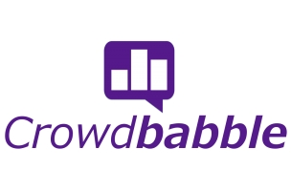
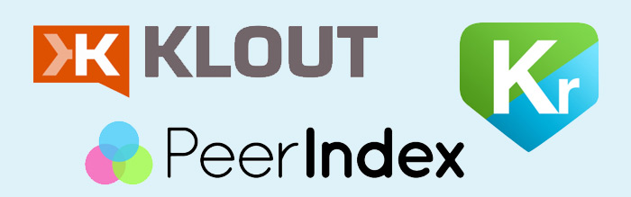

Measure your Social Media Success
socialmediaclub.org
Notes:
7. Analyze & Adapt
Analyze your social media campaigns, adapt any new findings into your current processes, and improve your efforts.
Testing and experimentation will perfect your social media efforts.
As you dive deeper into the never-ending pool of social media, you’ll quickly understand what works and what doesn’t.
Keep on learning.
After a while, you will learn best time to engage, best tool to use…

Slide 22













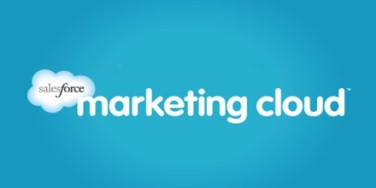

Social Media Reporting
socialmediaclub.org
Notes:
7. Analyze & Adapt
Analyze your social media campaigns, adapt any new findings into your current processes, and improve your efforts.
Testing and experimentation will perfect your social media efforts.
As you dive deeper into the never-ending pool of social media, you’ll quickly understand what works and what doesn’t.
Keep on learning.
After a while, you will learn best time to engage, best tool to use…

Slide 23
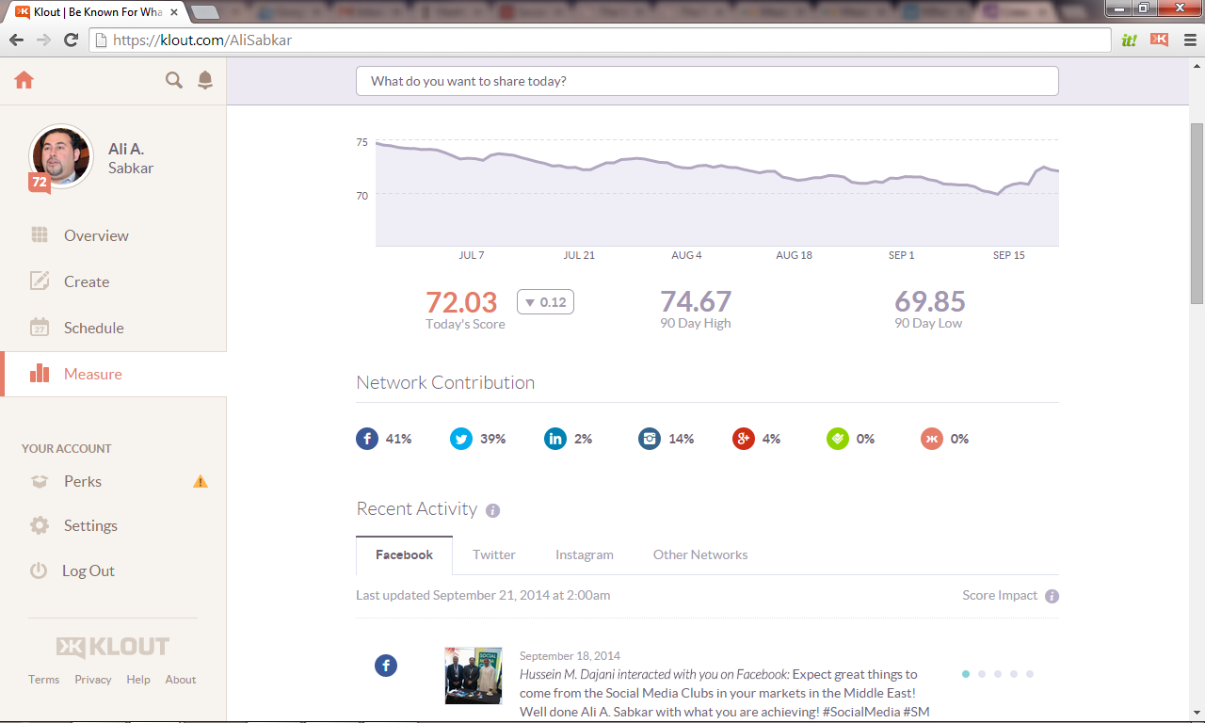
Klout.com

Slide 24
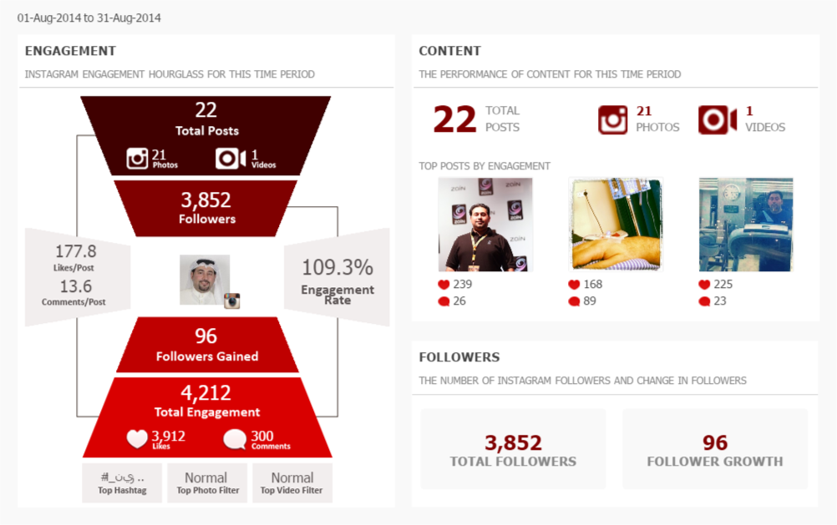
Crowdbabble.com

Slide 25
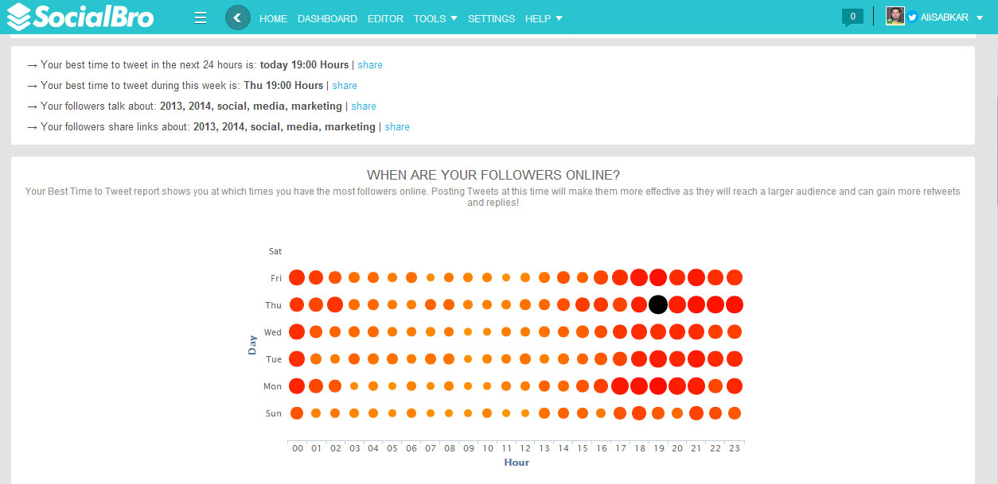
SocialBro.com

Slide 26
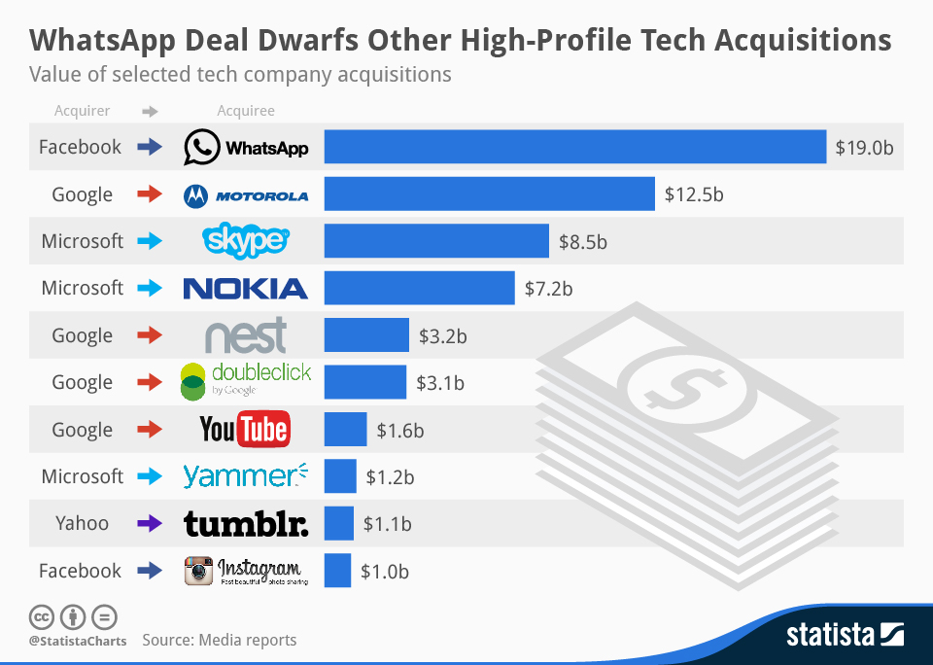
Social Media Learning
socialmediaclub.org

Slide 27
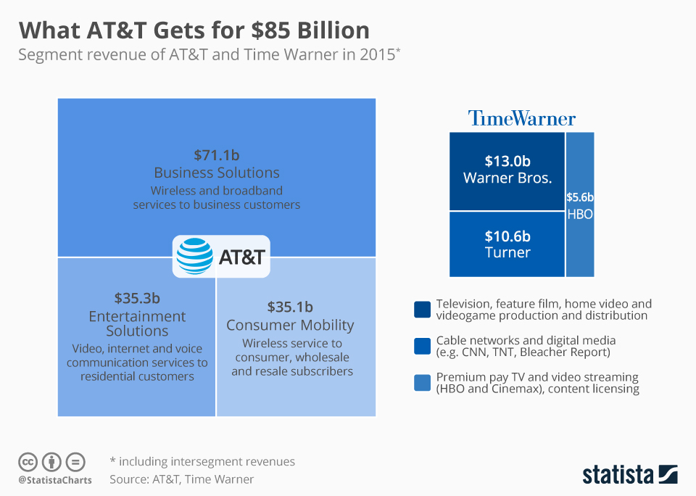
Social Media Learning
socialmediaclub.org

Slide 28
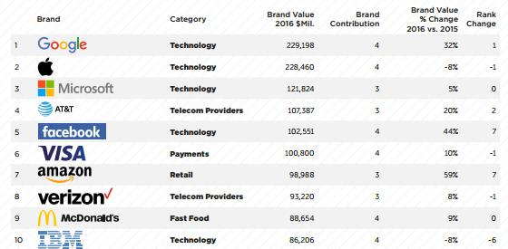
TOP BRANDS 2016
socialmediaclub.org

Slide 29
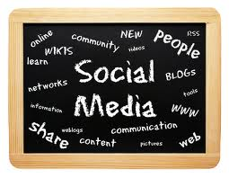
Social Media Learning
To use social media properly
you need to commit to it.
It takes time, experience, tools and expertise.
socialmediaclub.org

Slide 30



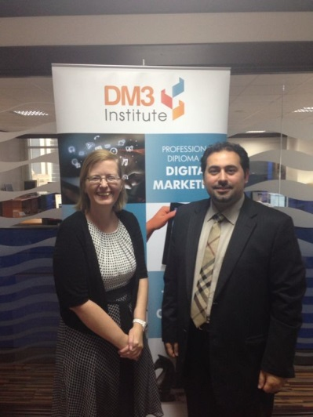
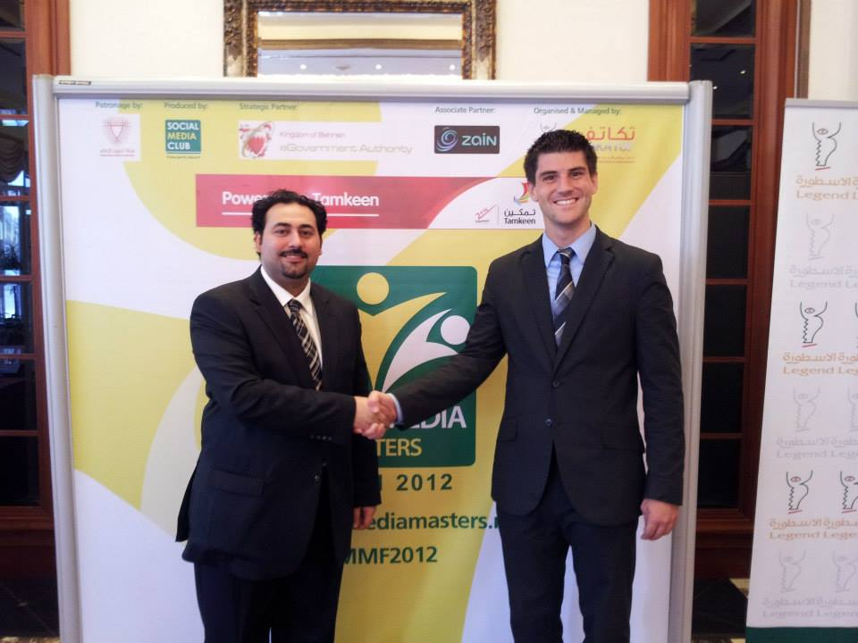
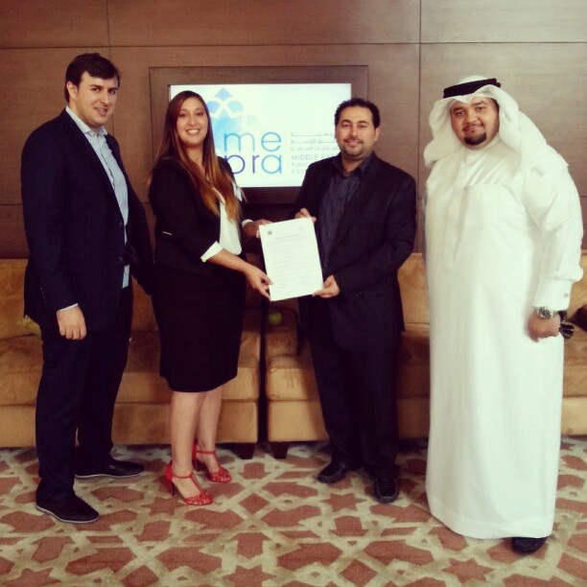
Social Media Club
Leading Online Communities in the Middle East with +500,000 SM users.
Organized +100 Learning Events in Middle East in the past three years.
Collaborate with +100 International Digital & Social Media Experts world wide.
Trained +10,000 professionals in the middle east in the past three years.
socialmediaclub.org

Slide 31
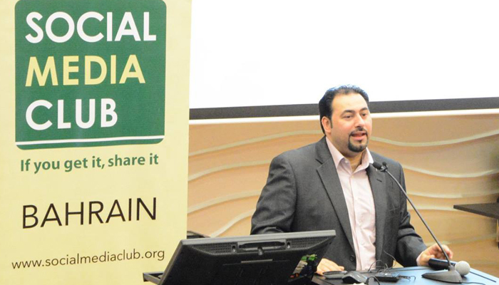
Social Media
The future for Social Media is unpredictable!"
SO!!!
LIVE THE PRESENT, ENGAGE & CONNECT WITH 2 BILLION USERS WORLDWIDE!
socialmediaclub.org

Slide 32

Thank you
@AliSABKAR
www.SocialMediaClub.org
@SMCBahrain

