Slide 1
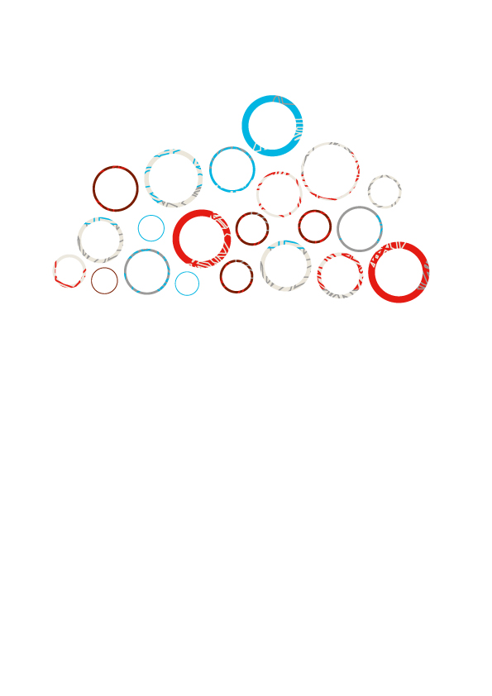

The Shift to Cloud Computing in Higher Education
2016 Arab ICT Forum
Raghda Zahran
MSc. Information Security, MA Education, PMP
BICT Programme Manager, Bahrain Polytechnic

Slide 2

The Shift to Cloud Computing
Cloud Computing (CC):
a “Disruptive Trend” assuming it will make information technology (IT) more responsive¹.
¹ Gartner Inc. (2016, 1 1). Gartner. Retrieved from TRENDING TOPICS: Cloud Computing:
http://www.gartner.com/technology/topics/cloud-computing.jsp
Notes:
Why you should attend ?
Cloud Computing (CC) is an emerging 21st Century technology. Gartner (2016) has described CC as a “disruptive phenomenon” assuming it will make an information technology (IT) organization more responsive. Furthermore, several studies have emphasized the need to move to the Cloud (Sultan, 2010; Susanto, Almunawar, & Kang, 2012; Koch, Assuncao, Cardonha, & Netto, 2015).

Slide 3
  EU
  Cloud Strategy
  in 2012
  Australia
  Cloud Computing Policy
  in 2010
r
  US
  Cloud First Policy
  in 2009
Governments are enforcing this shift like no other technology
Notes:
Why you should attend ?
Surprisingly, governments are enforcing this shift like no other technology. The US government, for example, issued a “Cloud First” policy in 2009 (Kundra, 2011; Figliola & Fischer, 2015). Furthermore, the European Cloud Partnership (ECP) Steering Board has adopted a “Cloud Partnership” (European Commission, 2014). Those initiatives aim at reducing the total cost of technology and improving the management of software and hardware services.
Aim: superior value for money and greater confidence in the ICT services.
Since governments are leading this shift on a large scale, we expect it to affect education (Saadatdoost, Sim, Jafarkarimi, & Saadatdoost, 2015; Sultan, 2010). This assumption may have emanated from the primary objective of higher education, which is preparing learners for future jobs (Saavedra & Opfer, 2012). Opponents to this objective argue that education does not have to lead to a vocation (Schultz & Higbee, 2007). However, I will focus on using CC for Information and Communications Technology (ICT) education which has a direct connection to the industry (Laurillard, Rethinking University Teaching , 2001; Erturk & Maharjan, 2014).

Slide 4

Scope
Using Cloud Computing (CC) for Teaching Information and Communication Technology (ICT) in Higher Education (HE)
SaaS
PaaS
IaaS
Software as a Service
Platform as a Service
Infrastructure as a Service
The shift to CC in education is …slower than industry
industry
education

Slide 5
Status Quo
Current research addresses
  capabilities, issues, and adoption challenges
  technical, social, and pedagogical or andragogical strands
Notes:
With this in mind, researchers have been addressing CC in pedagogical (Chen, et al., 2012; Vaquero, 2011; Lin, Wen, Jou, & Wub, 2014; Saadatdoost, Sim, Jafarkarimi, & Saadatdoost, 2015), technical (Lina & Chenb, 2012), and social (Thomas, 2010; Sultan, 2010; Lim, Graonlund, & Andersson, 2015) strands to name few. Apparently, studies that critically evaluate the effectiveness of CC with emphasis on teaching and learning are limited. Mostly, researchers have been addressing CC capabilities, issues, and adoption challenges. However, the reviewed literature in this study is dispersed and not exhaustive.

Slide 6
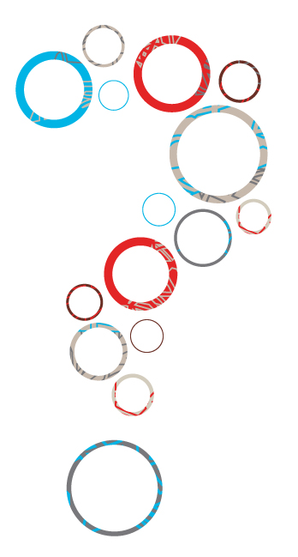
How can CC be useful for ICT courses in HEI?
What are the Affordances and Challenges of shifting to CC in Higher Education?
What are the Stakeholders Perceptions?
Notes:
The Question(s) we are trying to answer
In light of CC’s broad scope, evaluating it as a model can be challenging (Mell & Grance, 2011). However, I will follow a critical inquiry approach (Clear, 2005, p. 112). By doing so, my primary objective is to answer a question as to how can CC be useful for ICT courses in HEI?. In this study, I will argue that CC can be helpful for teaching ICT courses; but with careful consideration to some implications. While I will draw on educational theories, I endeavor to examine the literature (Clear, 2005, p. 112) with an interest in addressing issues, possibilities, and implications; which I hope to achieve within a specified period (Robson & McCartan, 2015).

Slide 7







Higher Education Context
Administrators
Educators
Technology providers
learners
Policy
Makers
Employers
Society
Notes:
What is special about the educational setting?
Utilizing CC in an academic setting, involves pedagogy, learning environment, and people (learners, educators, administrators, employers, policy makers, and technology providers) making it an interdisciplinary topic (Fincher & Petre, 2005). Such setting could be addressed through human sciences (Clear, 2005). Therefore, I draw on epistemological and social theories before I move to a framework. I have followed this tactic to identify underlying constructs related to this research (Creswell, 2015) and find a link between them in a logical manner. Namely, I focus on “Cognitive Interests”, “Communicative Action”, and “Conversational Framework”.

Slide 8




Higher Education Context
Assessment
Fixed academic calendar
Deep, authentic, leading to long life learning (3L)
Numerous and Simultaneous access
Classroom
or Lab
Pedagogy
and teaching strategies
Notes:
Why do we need learning?
To begin with, Habermas and Lenhardt (1973) argued that learners pursue knowledge based on interest. According to their “Cognitive Interests” theory (1973), stimulating interest could be through technical control, hermeneutic understanding, communication, or emancipating from power (Baynes, 2016, p. 32). Granted that cognition involves the processes of thinking, memory formation, problem-solving, and interest, it starts with a stimulus then progresses to motivation (Nextext, 2001) As a result of Habermas concepts; learning would ideally produce new interventions and innovations that are central to the development of the world.
I comprehend that these stimuli link somewhat to the objective of HEI, that is preparing people of real life settings. Under those terms, we can interpret the fitness of this theory with the use of ICT. After all, key qualification frameworks in education have emphasized that ICT literacy is an essential 21st-century competence; that is transferable amongst academic subjects (Partnership for 21st Century Skills, 2016; Great Schools Partnership, 2016; European Commission, 2016; EQF Reference Project, 2015).
However, Habermas’s contested approach in evidencing interventions through scientific inquiry indicates that developing technical power should follow a positivist stance (Baynes, 2016, p. 28). Conversely, we know from modern social theories that learning ICT is not exclusively studying objects, facts, and laws. On the contrary, it involves the human aspect, which intensifies the complexity of learning. In a trading zone (Fincher & Petre, 2005, p. 32) between Habermas and Lenhardt (1973) theory and the postmodernists, there has been an ongoing debate about the validity of each approach.
Nevertheless, the debate, whether learning is deductive or inductive, did not stop Habermas from developing a connection between personal and social motives (Baynes, 2016, p. 47). The new “Communicative Action” theory alludes to social interaction between people based on shared grounds and norms in an attempt to reach a mutual understanding. Claim to truth, normative rightness, and authenticity are considered drivers of communications. The primary difference between the two theories is that “Cognitive Interest” suggests that learning is intrinsic while the “Communicative Action” implies that interaction within a community of practice stimulates learning.
Drawing on those underlying constructs in Habermas’ epistemological and social theories, I choose the “Conversational Framework” (1999; 2001; 2008 ) as it focuses on learning ICT in HEI. The Framework formulates a logical structure that depicts the minimum components necessary for learning ICT. Laurillard agrees with Habermas that learners can achieve their goals through actions and congruent dialogue (Laurillard, 2001). In reality, this model is generic and could fit HEI where tutors can establish a dialogue with students virtually or in person. However, this mediation concept might be challenging to apply in institutions with large numbers of students where it’s difficult to create a conversation or for learning individually; where one contests their ideas and concepts.
In brief, Laurillard (Laurillard, 2001) describes the communication cycle between students and educators based on ideas, conceptions and beliefs to formalize grounds for learning. One further aspect of her framework is its application to learning with various computer technologies. However, it does not refer to CC, but it can be applied to encapsulate this research and give it boundaries. In the hope to explain what each party bring to the learning process, the framework assumes that students bring their conceptions, representations, individual epistemology to understand a particular topic (Laurillard, 2001, p. 40).
Evidently, the learning environment facilitates experiential, hands-on iterations to reach the learning goal. Laurillard expanded her model to discuss levels of authority and their influence on preparing an adequate learning environment. Additionally, this framework exhibits the organizational influence in promoting the learning environment (Laurillard, 2001). Although her interpretation of how the model would fit different situations including home users it may not perfectly fit. This study relates to Laurillard’s framework by focusing on the two primary participants (educators and learners) with the goal of learning ICT subjects using CC environment.

Slide 9
Key Affordances of CC in HE
3 models

Slide 10
Model 1
  documents storage
SaaS
  classroom discussions
The highest level abstraction layer² is the most prevalent service³.
  reflections
2 (Mell & Grance, 2012)
3 (Denton, 2012; Thomas, 2010; Lim, Graonlund, & Andersson, 2015; Lin, Wen, Jou, & Wub, 2014; Thomas, 2010)
Notes:
Most importantly, HEIs have used SaaS for pedagogical activities such as classroom discussions, reflections (Denton, 2012; Lin, Wen, Jou, & Wub, 2014). Academics have reported case studies on successful utilization of SaaS for student reflections and document management. However, they have experienced issues; to enumerate, bottlenecks in the data flow, lengthy setup process (account registration to access the software), additional time required to learn the Cloud-based software tools, and lacking the hands on skills.
Furthermore, technology providers have been provisioning SaaS in response to the demands of software licenses and ongoing upgrades (Denton, 2012; Lakshminarayanan et al., 2013). However, formally adopting some CC applications such as OneDrive (Microsoft (b), 2015), Dropbox (Dropbox, 2015), Google Drive (Google (b), 2015) created security concerns. Namely transferring sensitive data over the internet and relying on external parties (Murah, 2012 ; Arpaci, Kilicer, & Bardakci, 2015; Saadatdoost, Sim, Jafarkarimi, & Saadatdoost, 2015). Nevertheless, this did not impede academic institutions from espousing e-learning systems such as Moodle (2015) and Blackboard (2015) to manage their courses. On the contrary, the value of these systems outweigh the security concerns (Weber, 2011).

Slide 11
Model 2
PaaS
frees developers from the complexity of managing, administrating physical equipment
A middle abstraction layer,
that provides a software stack
and ready architecture for web
and mobile programmers⁴.
⁴ (Martin & Cendrowski, 2014)
Notes:
The second model is PaaS, a middle abstraction layer, that provides a software stack and ready architecture for web and mobile programmers (Martin & Cendrowski, 2014). PaaS is intended to free developers from the complexity of managing, administrating and the cost of acquiring physical computer equipment (Koch et al., 2015; Murah, 2012). Furthermore, the open source tool software readily available on the CC expands the students’ horizons beyond the curriculum content. However, there is little know about how effective is using PaaS inside the classroom. For example, Vaquero’s (2011) empirical study found that PaaS can be utilized by students learning ICT and other courses involving software development. However, his study did not evaluate how effective CC is in a computer lab.

Slide 12
Model 3
  enables systems administrators and users
  to deploy and configure computing machines, storage, network and utilities
IaaS
The physical layer “hypothetically”, the user does not see the tangible hardware. Deserves thorough evaluation ⁵.
  expands the students’ horizons beyond the curriculum content
⁵ (Ward & Barker, 2013)
Notes:
The third model is IaaS or the physical layer “hypothetically”, as the user does not see the tangible hardware. According to Stuart et al. IaaS is considered; the foundation of the previous two service models and, therefore, deserves a thorough evaluation (Ward & Barker, 2013). IaaS enables systems administrators and users to deploy and configure computing machines, storage, network (routers and connectivity) and utilities (monitoring and security tools) (Martin & Cendrowski, 2014). Besides, IaaS providers provision services with the capability of virtualization (software that acts like hardware) on servers (high performing computer machines) located in different data centers around the world (Martin & Cendrowski, 2014).
IaaS model has been applied by academic institutions to provide ICT from virtual computing labs (VCL) (Khmelevsky & Voytenko, 2010; Schaffer, et al., 2009; Chandra & Malaya, 2012; Klug & Bai, 2015); in which administrators provision computers and software to academic staff and students via a web browser. The most powerful aspect of this model is that students and educators use graphical interfaces to access virtual computer machines which they require for learning or experimenting ICTscenarios. In four case studies (Vaquero, 2011; Chen, et al., 2012) (Mew, 2015 ) reviewed for this paper ICT educators have integrated IaaS for teaching ICT in their curriculum.

Slide 13
Key Affordances of CC in HE
OPEX and CAPEX reduction
freeing learners from the complexity
enabling hands-on experiential learning
expanding the learning spaces
fostering innovation

Slide 14
Key Challenges of Shifting to
CC in HE
Notes:
The shift of education to CC promises a provision of a pool of scalable technology resources; as mentioned in the previous section (Figliola & Fischer, 2015). However, the richness and scalability bring along some issues. We may assume that academic institutions have fully recognized CC (Martin & Cendrowski, 2014). In reality, the shift to CC in education is slower than industry (Lim, Graonlund, & Andersson, 2015; Sultan, 2010; Klug & Bai, 2015; Sriram & Khajeh-Hosseini, 2010). I can account to this hindrance from my personal experience as an ICT educator. Since it is hard to cover all the CC problems in one document, I will focus on challenges that surfaced from the literature review. Key challenges that percolated which I will address include slow CC adoption, shallow learning, educators’ development, vendor-lock, digital discovery, and the digital divide.

Slide 15

Controversy about CC definition
an underlying model that provisions technology services⁶ .
“large pool of computing power”
“Internet-based service”
“distributed computing paradigm”
6 (NIST, 2011)
Notes:
To begin with, CC’s broad range of constructs has caused controversy about its definition (Ward & Barker, 2013). In the reviewed literature, researchers have introduced constructs. For example, some researchers have alluded to the primary requirement for running CC being “Internet-based” service (Bouyer & Arasteh, 2014; Darío, Ortega, Antonio, & Ricaurte, 2014; Lakshminarayanan, Kumar, & Raju, 2013; Mirashe & Kalyankar, 2010; Sriram & Khajeh-Hosseini, 2010). Others have emphasized the broad range of technology resources by attributing it as a “large pool” of computing power (Blue & Tirotta, 2011). Furthermore, researchers who realize CC disperse structure have described it as a “distributed computing” paradigm (González-Martínez, Bote-Lorenzo, Gómez-Sánchez, & Cano-Parra, 2014; Khmelevsky & Voytenko, 2010; Susanto et al., 2012).These manifold descriptions are somewhat CC involves, but all fall under the overarching definition proposed by the NIST.
According to the National Institute of Standards and Technology (NIST) (Mell & Grance, 2011), CC is an underlying model that provisions technology services (software, compute, network and storage) in sub-models namely, Software as a Service (SaaS), Platform as a Service (PaaS), and Infrastructure as a Service (IaaS). The services can be deployed in four strategies Private (hosted internally), Community (shared between companies), Public (hosted externally), and Hybrid (a combination of more than one model). The services and deployment strategies feature On-Demand Self-Service, Broad Network Access, Resource Pooling, Rapid Elasticity, and Measured Service.
Apparently, this controversy of CC definition may have caused dissidence about the significant factors affecting its adoption. On an organizational level, a survey of ICT professionals (Klug & Bai, 2015) reveals that complexity (difficulty), technology readiness (ICT infrastructure and human resource expertise), and organizational size (number of employees and annual revenue) are major concerns for adopting CC. Another survey of School Principals (Lim, Graonlund, & Andersson, 2015) shows that oppositions from authorities due to concerns about risks of privacy and security breaches affect the adoption of CC. On a personal level, a study of community college students (Behrend, Wiebe, London, & Johnson, 2011) presents ease of use being more significant to students than usefulness. This result illuminates a lack of interest of what CC can offer which raises a concern about deep learning (Jensen & Nickelsen, 2008).

Slide 16
Operational
complexity
  perceived difficulty
  organizational size (number of employees and annual revenue)
technology readiness
  ICT infrastructure
  ICT services expertise
Notes:
What would stop or slow you if you plan to use CC in your daily operations?

Slide 17
Security
vendor-lock
  bespoke CC tools and specific standards
  education consumerism
  reliance on a third party
  records retention
Notes:
What kind of security concerns use CC in your daily operations?
The specificity of CC offerings has created a vendor-lock issue (Mckendrick, 2011). Leading technology providers are offering their bespoke CC tools (Martin & Cendrowski, 2014) via alliances, grants, and partnerships, which may have resulted in education consumerism and marketization, a controversial issue in the academic community. Moreover, teachers’ reliance on a third party could lead to mistrust and security concerns. Namely, the trust may be one of the factors hindering the adoption of CC (Wu, W. Lan, & Lee, 2013). Technology vendors have one agenda for offering their free or reduced cost services; that is increasing their market share. Therefore, timely responding to academics’ requests and concerns may not be a priority.

Slide 18
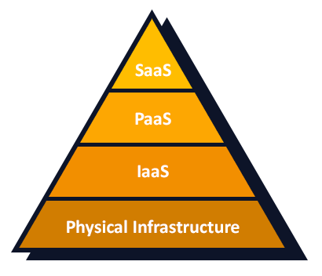










Trending Technologies
Notes:
What kind of security concerns use CC in your daily operations?
200-300 USD Free Trial Service >> Account Registration with a Credit Card
Open Stack NOVA, Neutron and Swift
Vmware Vcloud Air
IBM Softlayer IMS and Bluemix
Google Cloud
Joyent
ScaleMatrix
The 6 Degrees
Oracle Cloud
SAP Cloud
…

Slide 19
Security
digital discovery
  virtual communication
  plagiarism
  confidence in services provided by academic institutions
  violation of ethical procedures
Notes:
What kind of security concerns use CC in your daily operations?
Another twofold aspect that is caused by vendor control is the digital discovery. A user connected to CC, or who saves pictures, emails, files can easily be located (Martin & Cendrowski, 2014, p. 102). This capability could be an opportunity for enabling virtual communication. To put it differently, even saving files on a local device connected to CC via an application for example Pocket Cloud (see http://pocketcloud.com/), they are subject to discovery. Laurillard (2001) alluded to students having full confidence in services provided by academic institutions; therefore, might not be careful of how they use it. With vendors’ controlling ICT resources breaching data privacy is on the rise; although it may enable virtual communication and collaboration opportunities. HEIs have utilized this capability for exchanging research files ( (Gangwar, Date, & Ramaswamy, 2015), but this may cause breaches for standard research ethical procedures.
Surprisingly, the dependency of CC on the Internet may have created a new form of digital divide. The seamless spread of the Internet to individuals and small organizations has enabled the diffusion of CC. According to the Internet world statistics, there are more than three billion internet users (Real Time Statistics Project, 2015) and the number is exponentially growing. However, internet connectivity is exclusive to the users who can afford and access the internet (Skaletsky, Galliers, Haughton, & Soremekun, 2016). The assumption that CC will minimize the digital divide may seem over optimistic. This reservation is possibly valid due to two main reasons. First, despite the expansion of the internet, there are still 60% (Real Time Statistics Project, 2015) of the world population who are not connected. Besides, the reliance of CC on the internet makes the assumption that technology inaccessibility lucid.

Slide 20
Pedagogy
setting
  lengthy setup and JIT Access, response, latency and bottle necks
  digital divide, 60% world population is not connected
shallow learning
  ease of use and procedural activities
Notes:
CC ease of use may entail shallow learning, particularly of computer concepts. Laurillard (2001, p. 69) suggests Phenomenography as a more productive teaching and learning strategy than Instructional and Constructivist approaches. Phenomenography promotes expressing learners and educators’ conceptions (Creswell, 2015)in which the learner undertakes a task towards a goal, and then discusses conceptions with the educator in an iterative and inductive dialogue (2001). However, using CC to program applications or create virtual storage space or computer environment as part of learning ICT development involves some procedures. Laurillard (2001, p. 138) describes them as tutorials that require an explicit description of a goal (Jensen & Nickelsen, 2008). From this notion, we may conclude that procedural activities do not achieve the goal of learning (Jensen & Nickelsen, 2008, p. 4) as to have the motivation to learn deeply through challenges that are slightly above their abilities.
Building on the need for deep learning (Jensen & Nickelsen, 2008)., CC can be employed in teaching strategies that follow constructivism (Denton, 2012) or phenomenography (Laurillard, 2001, p. 69), which requires educators’ expertise and competence. Bonwell and Eison (1991) argued that educators are the primary reason behind resistance to change. Similarly, Ertmer & Ottenbreit-Leftwich (2010) discussed educators’ use of computers for administrative tasks or in an instructional approach could be the reason behind the ineffective use of technology in the classroom.

Slide 21
Pedagogy
educators’ expertise and competence
  administrative tasks
  instructional approach
  teach the way they have learned
Notes:
Accordingly, educators’ development is equally important (2001) since the technology is changing. Ertmer & Ottenbreit-Leftwich (2010) insist that knowledge is the key to integrating ICT in education. Although CC as a paradigm (Saadatdoost, Sim, Jafarkarimi, & Saadatdoost, 2015)of implementing technology (having software run on a distant computer) is not new, leading technology providers have been developing their specific standards, protocols, and tools (Missbach, et al., 2016). Therefore, ICT educators who might be versed in using technology need to master new CC tools. The drop back in academics ongoing development of new technologies requires financial support which is managed by administrators and time that could be constrained by a fixed academic calendar.
What is most compelling for ICT educators’ development is their acceptance to learn technology in new pragmatic ways. Most undergraduates nowadays were born during the emergence of CC era in the 90s (Prensky, 2001; Helsper & Eynon, 2010). They are users of CC even if they do not know it; through the social networking, mobile apps, wearable health and fitness tools, etc. Students bring this knowledge with them to the classroom (Laurillard, Rethinking University Teaching , 2001, p. 39). To challenge them beyond what they already know, educators must demonstrate confidence in using CC.
According to Laurillard (2001, p. 97) educators’ conceptions are central to the learning process. Ertmer & Ottenbreit-Leftwich (2010) call to help teachers use technology for deep learning (Jensen & Nickelsen, 2008). Requires a resilient change to the content and context of learning. They relate the delay in change to teachers’ lack of relevant knowledge, low self-efficacy and beliefs. Since there are new models and strategies of operating CC, educators’ reluctance to exploit it. This hesitance is only realistic, but can inhibit the shift to CC. for that reason; teachers may be resistant to changing their understanding of concepts and pragmatic ways of operating technology.
For example, connecting virtual machines over PaaS or IaaS is done mainly via hypertext transfer protocol (HTTP); which refutes physical deployment with switched networks, crossover cabling with Ethernet, Bluetooth, Wireless Networking, etc. Teachers may see that this is a hindrance to the learning of computer connectivity concepts. Furthermore, doing things with computers may be done with alternative ways. A teacher who is routed in following a procedure may find it ambiguous to change their way. For example, educators who operated Linux systems using bash programming and scripting may find displeasure in using Windows graphical user interface (GUI); but the opposite apply as well. I know teachers who find users of GUI novice and lack in-depth ICT knowledge and experience.
To a great degree, teachers have pride in what they know and do; they have developed this self-confidence (Baynes, 2016, p. 32) with hard work. Bonwell & Eison (1991) have alluded to teachers being enchanted while lecturing; which indicate their vanity of their voices. Furthermore, their popularity with students put them on the spot as celebrities (Russell, 2010). The classroom aesthetic (Russell, 2010). To an ICT academic may be different than teachers of other subjects. It’s usually determined by running machine power and speedy ticking keyboards which indicates students in action. To them, the ambiance of utilized machinery can only be achieved by mastering technology. However, they tend to teach the way they have learned. Therefore, they might be hindered by fear of skill rating.

Slide 22
What’s Next?
Change will happen… if
  there is clarity CC definition
  HEIs facilitate academics mastery of CC
  governments implement adoption strategy
Evaluate the effectiveness of CC
  Survey recent literature (exhaustive)
  Experiential Research (in the classroom)
Notes:
In conclusion, this research found that utilizing CC for ICT courses is promising. However, the envisaged opportunities are manifolds. Therefore, careful considerations must be taken to ensure effective implementation. In this paper, I endeavoured to contest the literature looking for underlying issues and opportunities that could directly affect teaching ICT courses. I argued that CC could be a useful 21st-century technology for teaching ICT granted careful decisions are taken. I concede that there are some limitations in this research. Most importantly, it is based on a literature review on an “emerging” technology. Rigorous research on its efficacy for education is limited. Although desk research is a valid methodology (Robson & McCartan, 2015) for exploring new topics, the reviewed literature is selected and not exhaustive; which means that I may have overlooked imperative studies. Furthermore, I have not examined several important educational aspects such as using CC for assessment, curriculum design, research, and pedagogy. Such topics demand an in-depth investigation. However, this limitation opens the space for future research using a desk and empirical research to grasp a thorough understanding of specific ramifications applicable to a context.

Slide 23
Q&A

Slide 24
Trending Technologies
Notes:
200-300 USD Free Trial Service >> Account Registration with a Credit Card
Open Stack NOVA, Neutron and Swift
Vmware Vcloud Air
IBM Softlayer IMS and Bluemix
Google Cloud
Joyent
ScaleMatrix
The 6 Degrees
Oracle Cloud
SAP Cloud
…

Slide 25
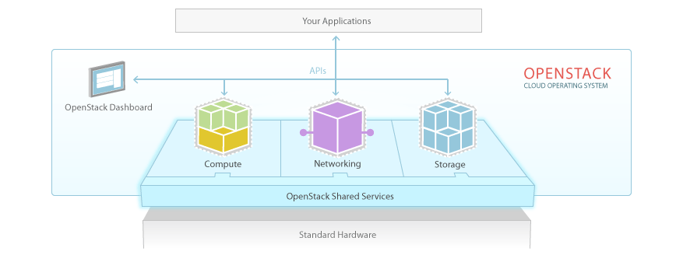
Open Stack

Slide 26
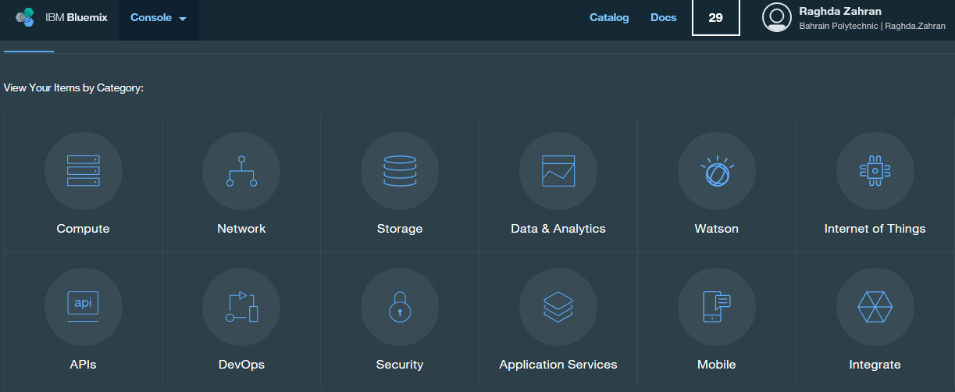
IBM BlueMix

Slide 27
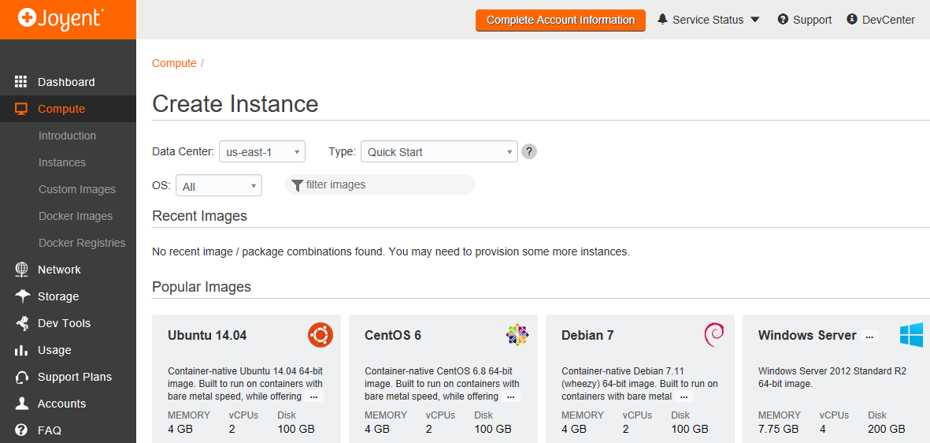
Joyent

Slide 28
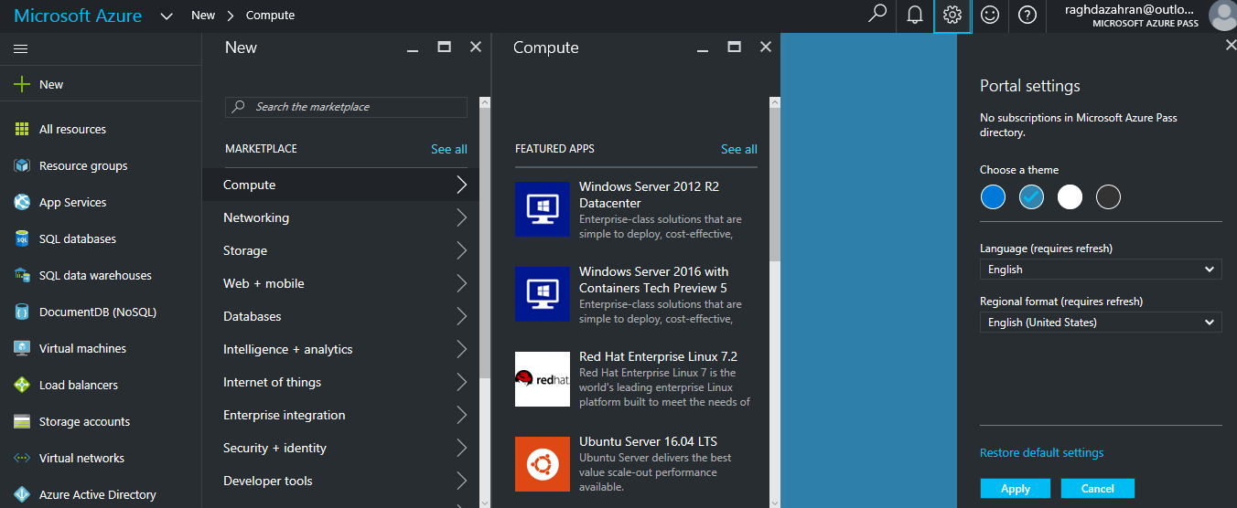
Azure

Slide 29
Thank You

